Slide 1

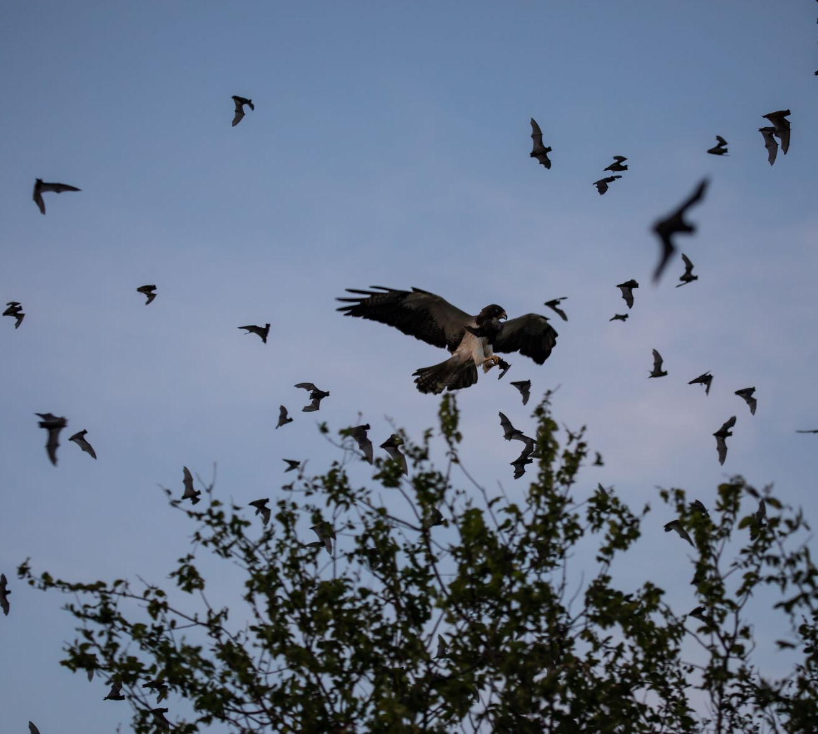
Mexican Free-Tailed Bats
Grades 3 - 5
Food Chains & Webs
Image: Fin & Fur Films Productions
Notes:
A bird of prey hunts Mexican free-tailed bats near Bracken Cave in Texas. Image: Fin & Fur Films Productions

Slide 2

Engage
Meet the Mexican Free-Tailed Bat
MEXICAN FREE-TAILED BATS

Slide 3
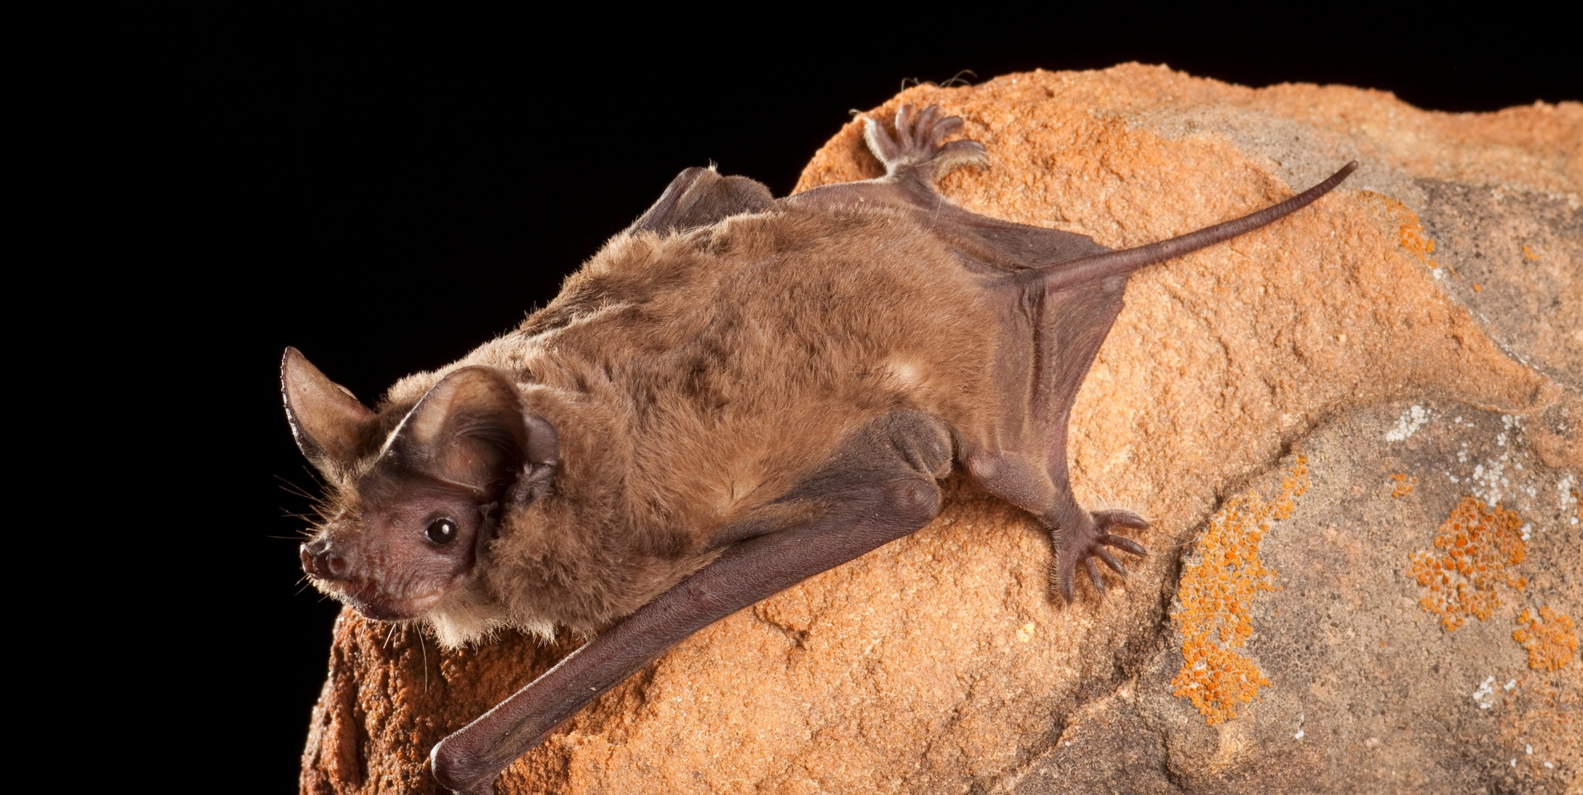
Image: Bat Conservation International 106653-19-2508x1260 https://www.batcon.org/bat/tadarida-brasiliensis/
MEXICAN FREE-TAILED BATS
Notes:
Mexican free-tailed bat image: Bat Conservation International 106653-19-2508x1260 https://www.batcon.org/bat/tadarida-brasiliensis/

Slide 4
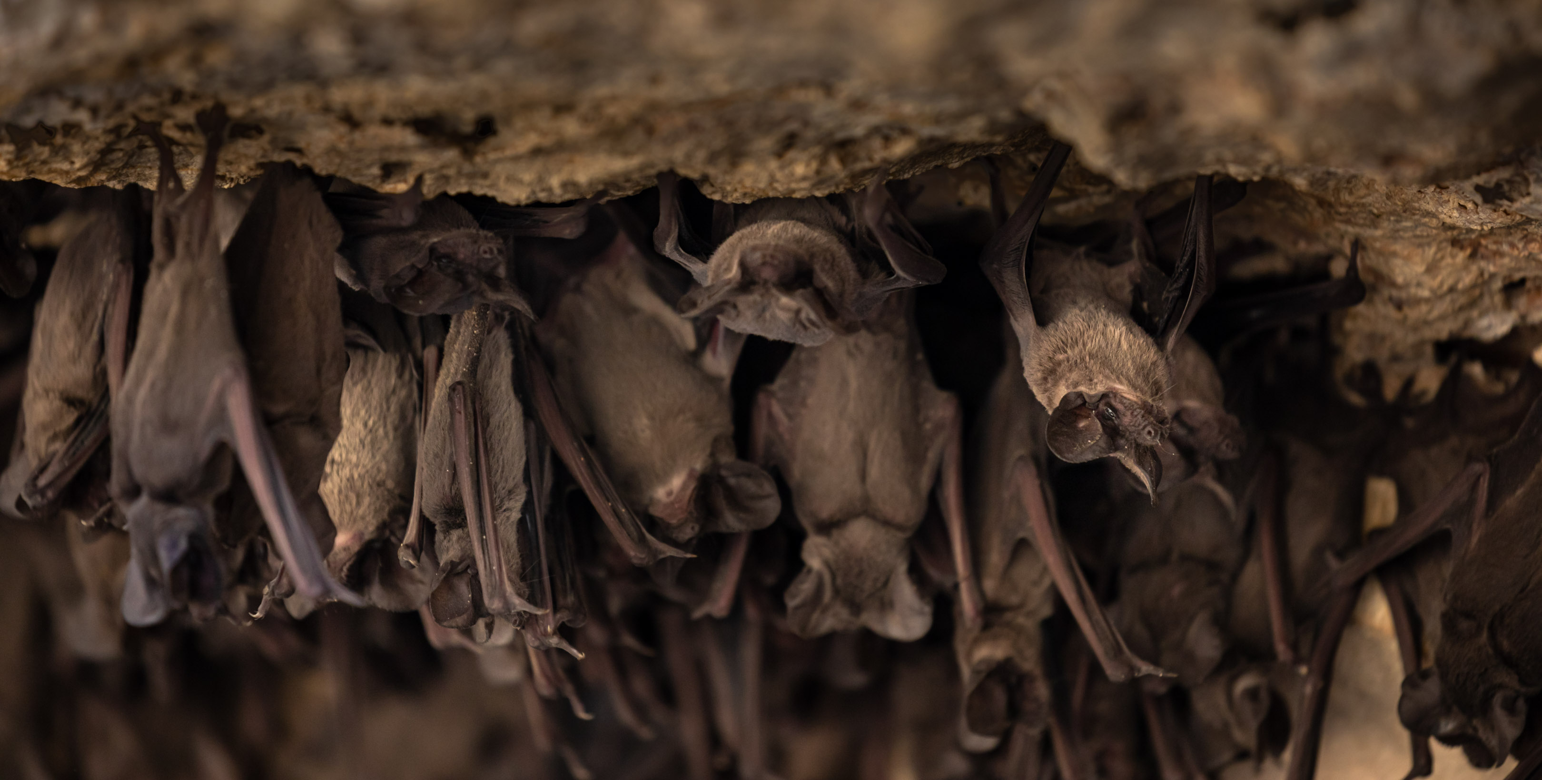
Image: Fin & Fur Films Productions
MEXICAN FREE-TAILED BATS
Notes:
Mexican free-tailed bats image: Fin & Fur Films Productions

Slide 5
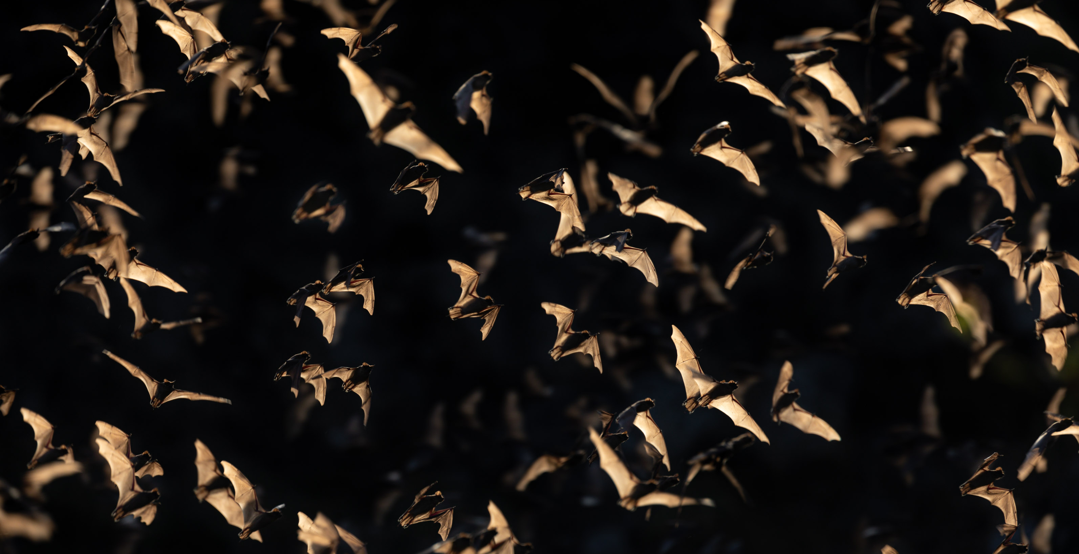
Image: Fin & Fur Films Productions
MEXICAN FREE-TAILED BATS
Notes:
Mexican free-tailed bats image: Fin & Fur Films Productions

Slide 6
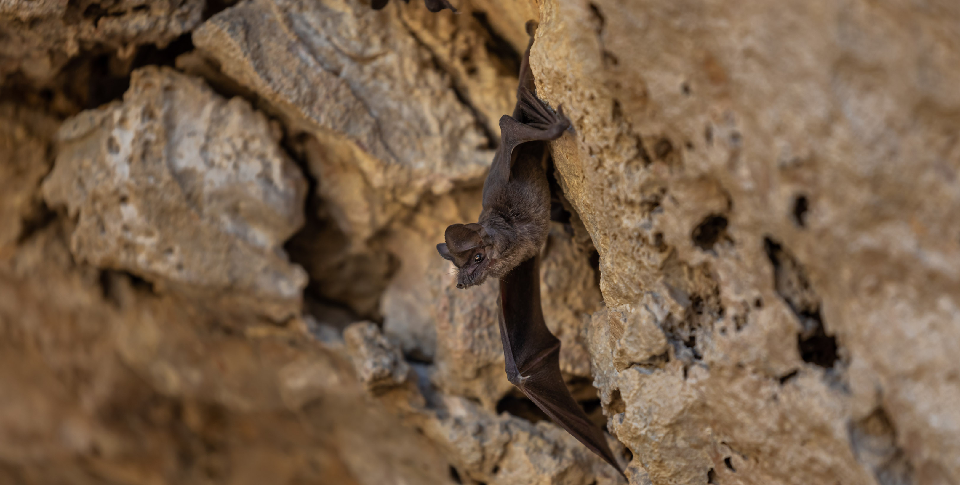
Image: Fin & Fur Films Productions
MEXICAN FREE-TAILED BATS
Notes:
Mexican free-tailed bat image: Fin & Fur Films Productions

Slide 7
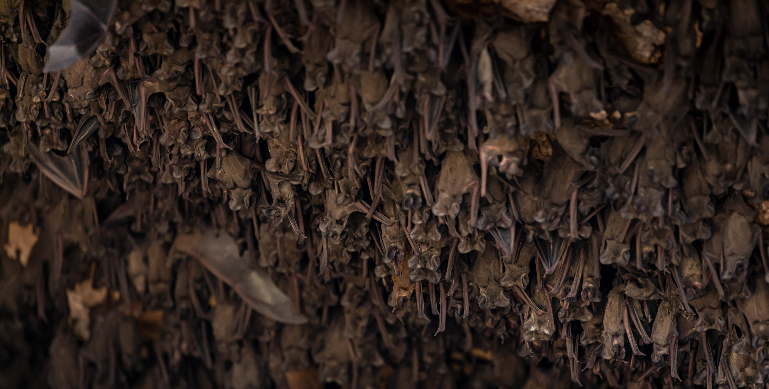
Image: Fin & Fur Films Productions
MEXICAN FREE-TAILED BATS
Notes:
Mexican free-tailed bats image: Fin & Fur Films Productions

Slide 8
Explore 1
More About Mexican Free-Tailed Bats
MEXICAN FREE-TAILED BATS

Slide 9
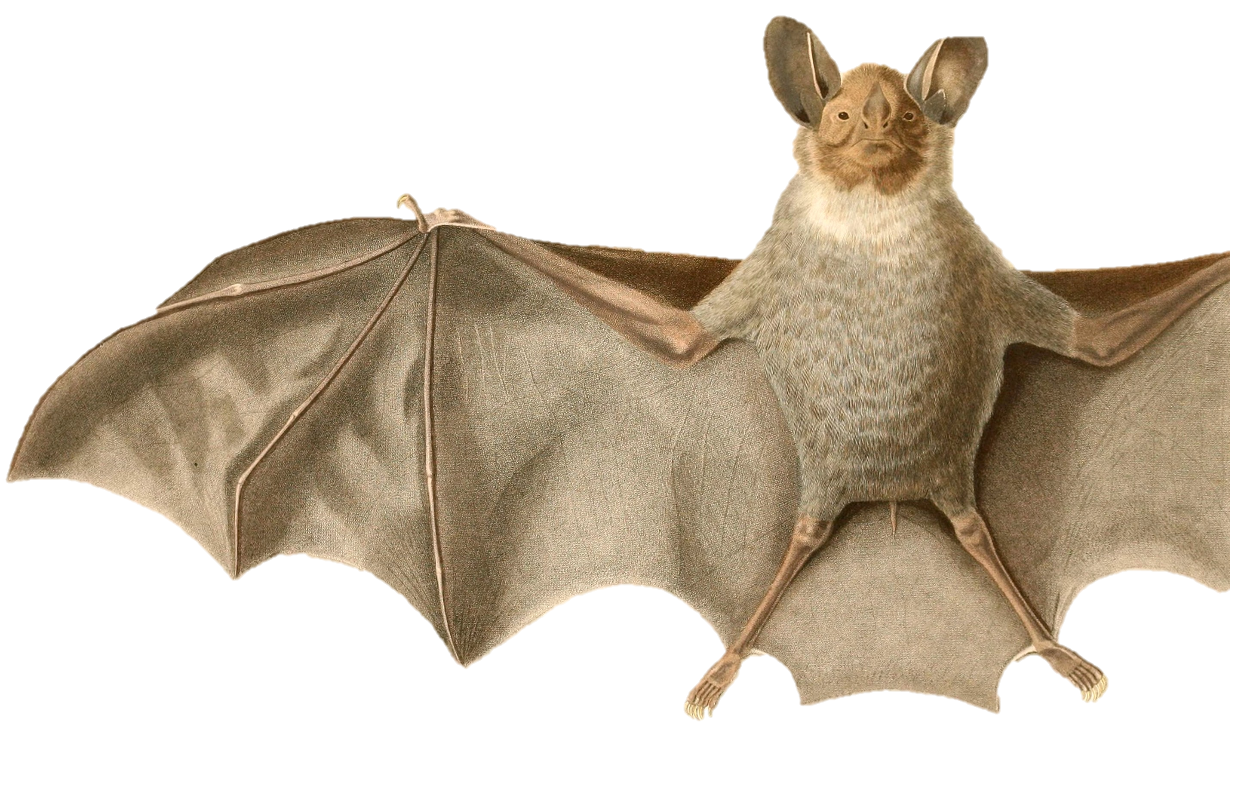
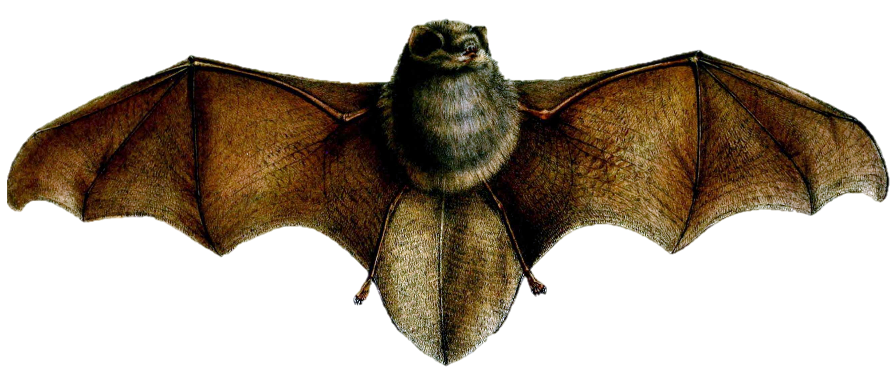
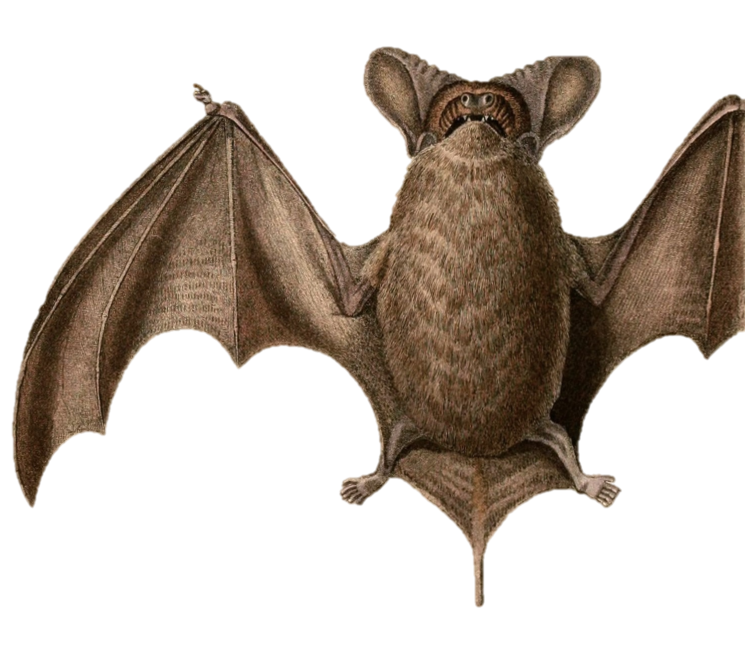
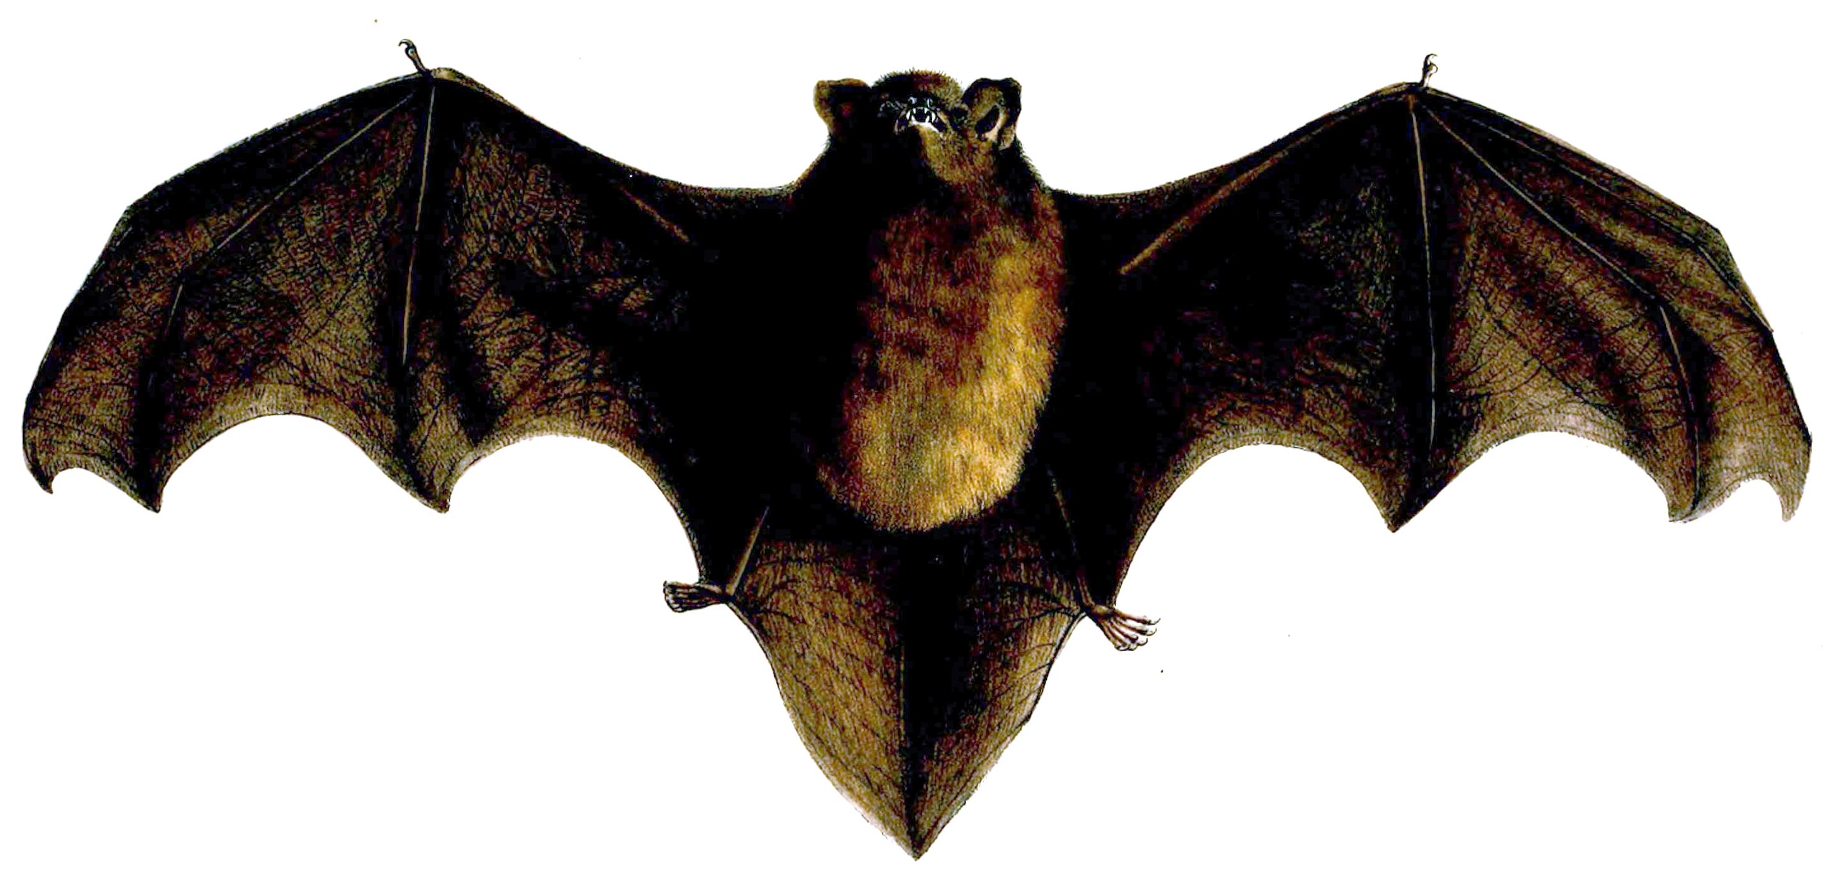
What do you notice about these bats’ tails?
Thumbless Bat
White-Throated
Round-Eared Bat
New Zealand
Long-Tailed Bat
Why do you think
Mexican free-tailed bats have
“free-tailed” in their name?
Mexican Free-Tailed Bat
Notes:
Image Sources:
Tadarida brasiliensis brasiliensis (Subspecies of Mexican Free-tailed Bat) by Alcide Dessalines. Public Domain, https://commons.wikimedia.org/w/index.php?curid=20018017
Thumbless Bat by G.H.Ford - Proceedings of the Zoological Society of London (vol. 1856, plate Mammalia XLII), Public Domain, https://commons.wikimedia.org/w/index.php?curid=60271758
New Zealand long-tailed bat Scotophilus tuberculatus By GH Ford - Proceedings of the Zoological Society of London 1857 (web), Public Domain, https://commons.wikimedia.org/w/index.php?curid=15263264
Lophostoma silvicolum (White-throated Round-eared Bat) by Alcide Dessaline. Public Domain, https://commons.wikimedia.org/w/index.php?curid=20017135

Slide 10
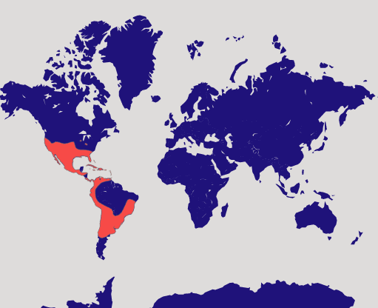

Map: Bat Conservation International https://www.batcon.org/bat/tadarida-brasiliensis/
Do Mexican free-tailed bats live in your area?
Map Key
Mexican free-tailed
bats live here.
Notes:
Mexican free-tailed bats live in the southern part of North America, Central America, and parts of South America.
Map Source: Bat Conservation International https://www.batcon.org/bat/tadarida-brasiliensis/
Compass Rose by imaginationlol on Flaticon https://www.flaticon.com/free-icon/wind-rose_4031900?term=compass+rose&page=1&position=2&origin=search&related_id=4031900

Slide 11
Table 1
Do you think bats are an important animal in our ecosystem?
Why? | Why not?
MEXICAN FREE-TAILED BATS

Slide 12
Explore 2
Bats of Bracken Cave
MEXICAN FREE-TAILED BATS

Slide 13
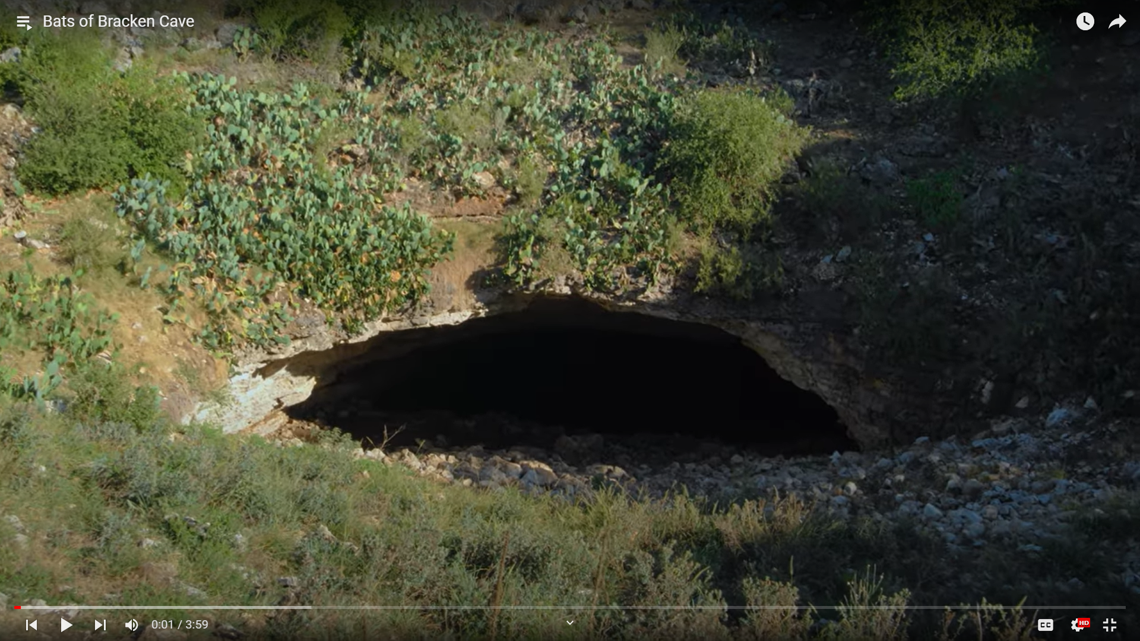
Notes:
Deep in the Heart Bats of Bracken Cave This video is also available on YouTube: https://youtu.be/H-q58Jd50Lk?si=1j1TePoUr2TrAiua The video is 4 minutes.

Slide 14
Table 2
What did you notice about Mexican free-tailed bats?
MEXICAN FREE-TAILED BATS

Slide 15
Explore 3
Predators & Prey of Mexican Free-Tailed Bats
MEXICAN FREE-TAILED BATS

Slide 16
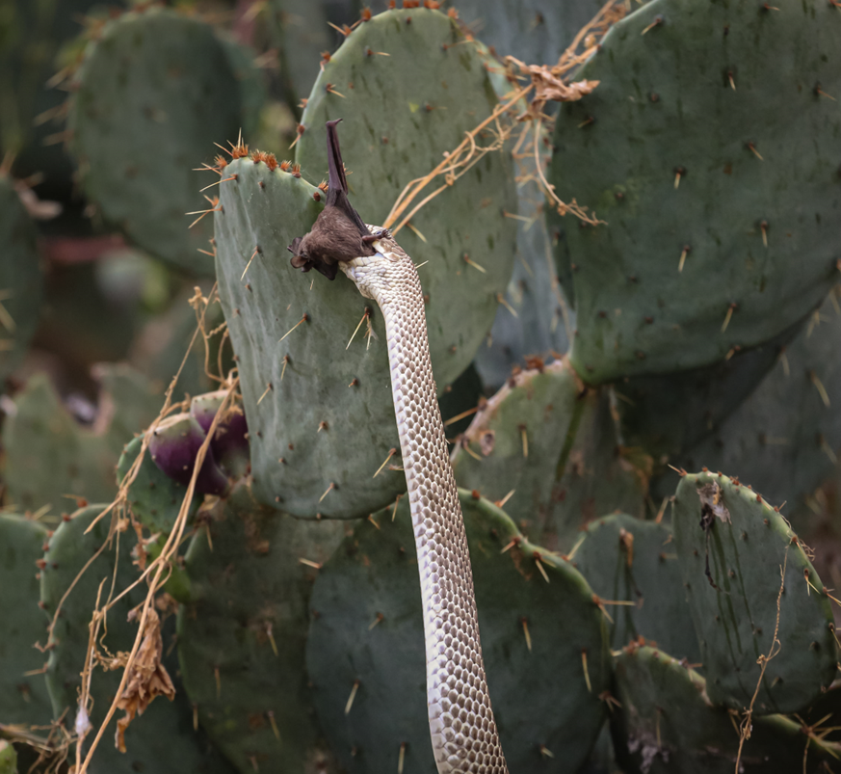
predator
predator
an animal that kills and
eats other animals
prey
prey
an animal that is killed and
eaten by other animals
Image: Fin & Fur Films Productions
MEXICAN FREE-TAILED BATS
Notes:
Coachwhip snake captures a Mexican free-tailed bat near Bracken Cave in Texas image: Fin & Fur Films Productions

Slide 17
Table 3
What do Mexican free-
tailed bats eat?
What eats Mexican free-tailed bats?
MEXICAN FREE-TAILED BATS

Slide 18
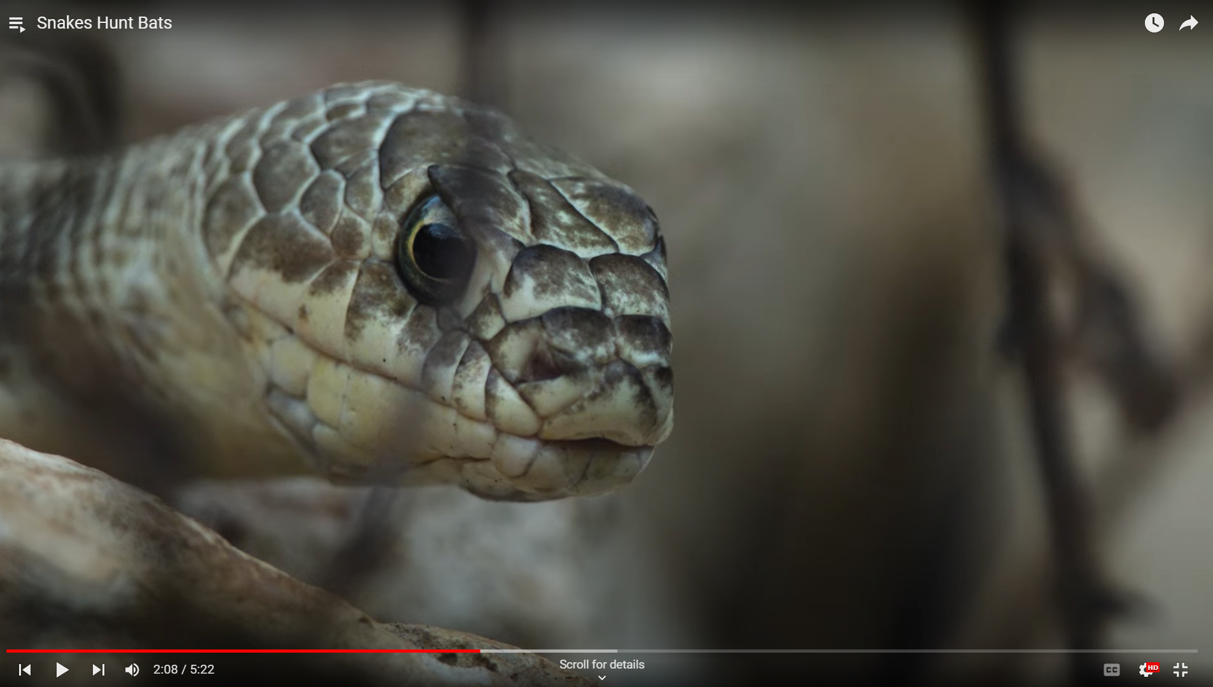
Notes:
Deep in the Heart Snakes Hunt Bats This video is also available on YouTube: https://youtu.be/60Zf7-hLS4E?si=RmHjTr73O0oyXQCS The video is 5 minutes and 22 seconds.

Slide 19
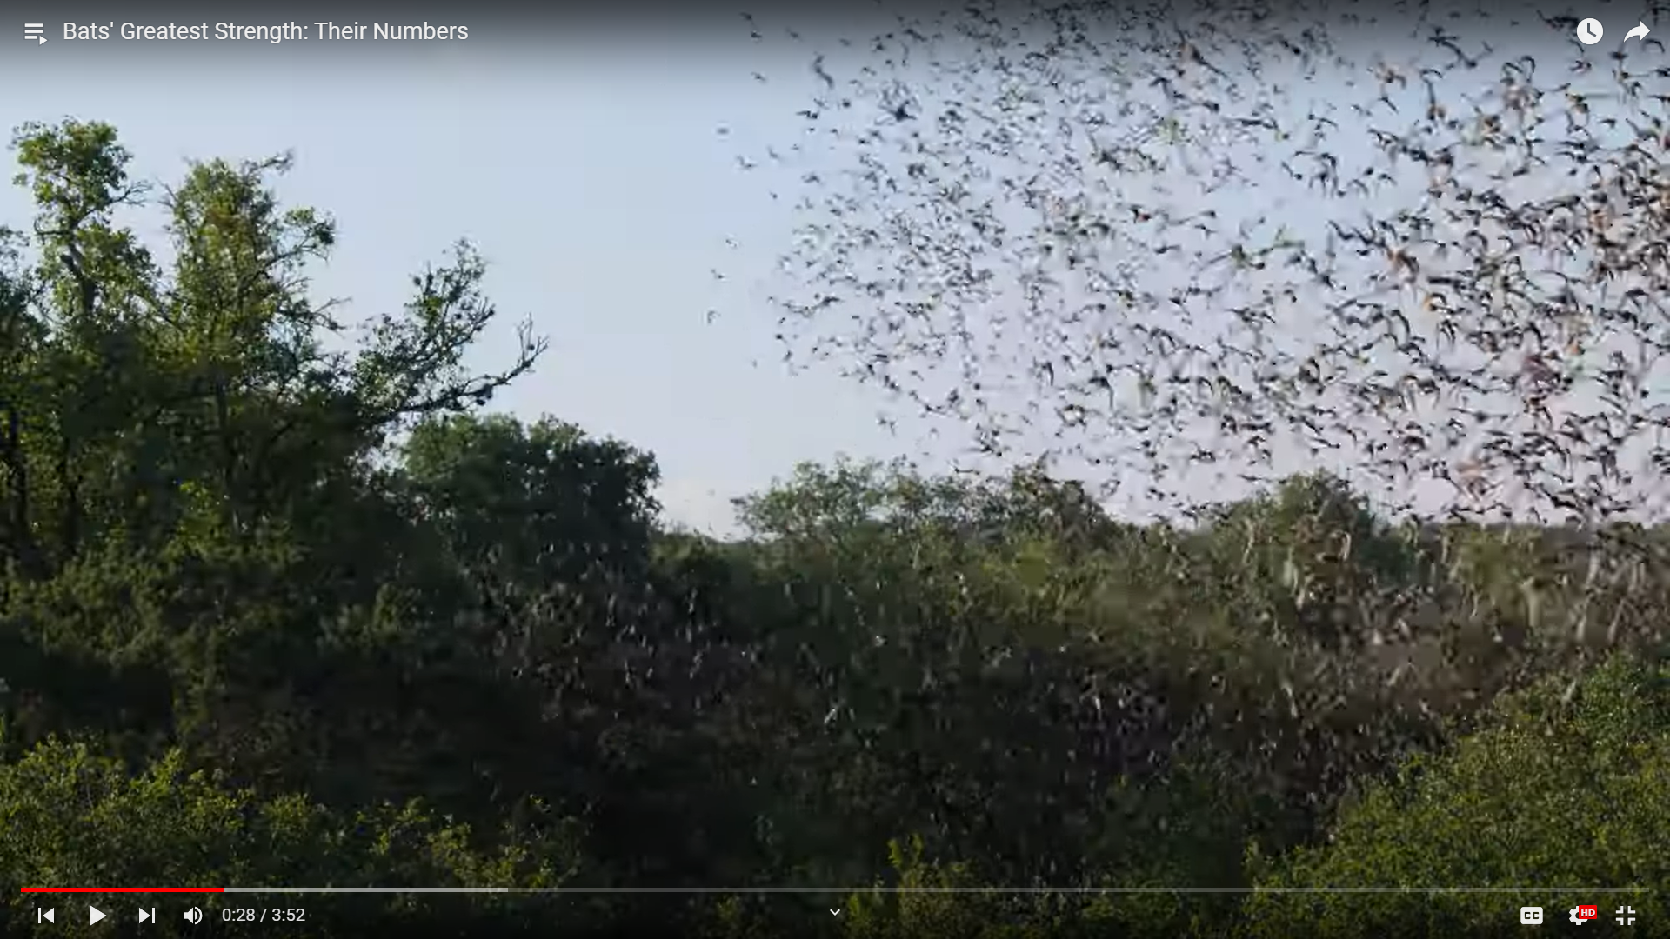
Notes:
Deep in the Heart Bats' Greatest Strength: Their Numbers This video is also available on YouTube: https://youtu.be/Va7otBnHq_s?si=lZjAKVvxg2ujWA60 The video is 3 minutes and 50 seconds.

Slide 20
Explain
Food Chains/Food Webs
MEXICAN FREE-TAILED BATS

Slide 21

What would happen if all the bats in your group’s
food chain or food web died?
Take the bat out of your group’s food chain or food web.
With your group members, discuss what would happen to the other organisms if all the bats died.
MEXICAN FREE-TAILED BATS
Notes:
Icon by b farias CL from Noun Project

Slide 22
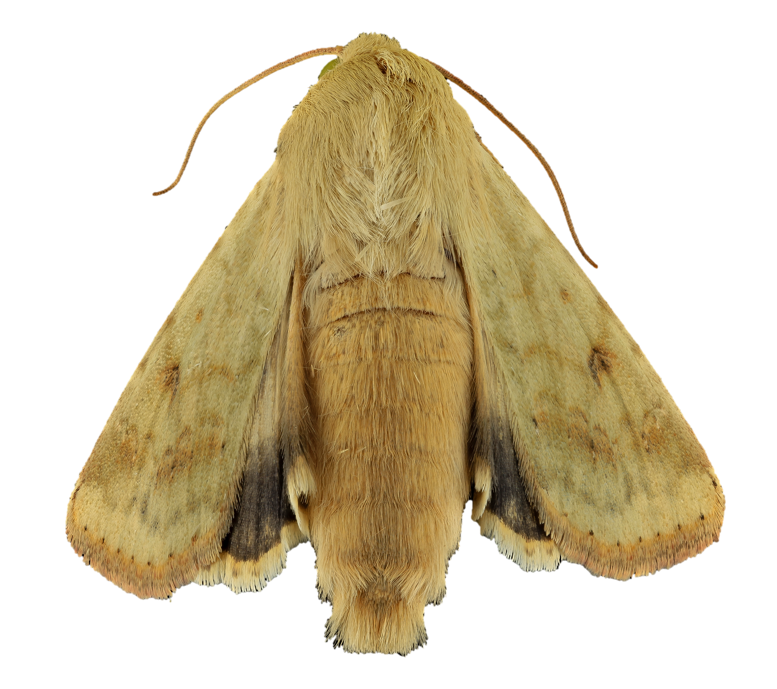
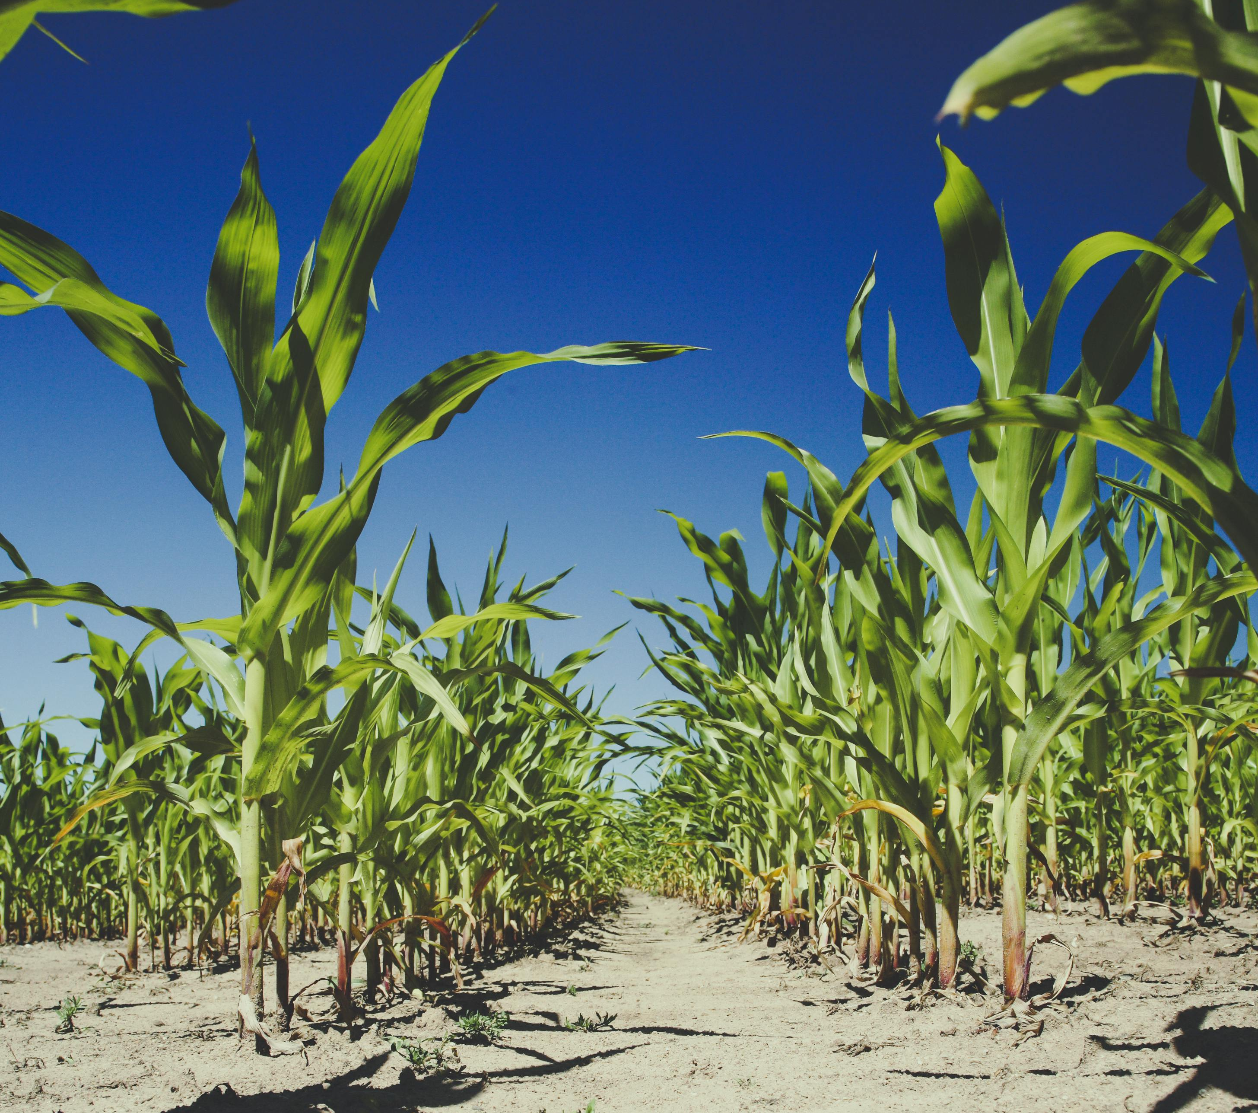
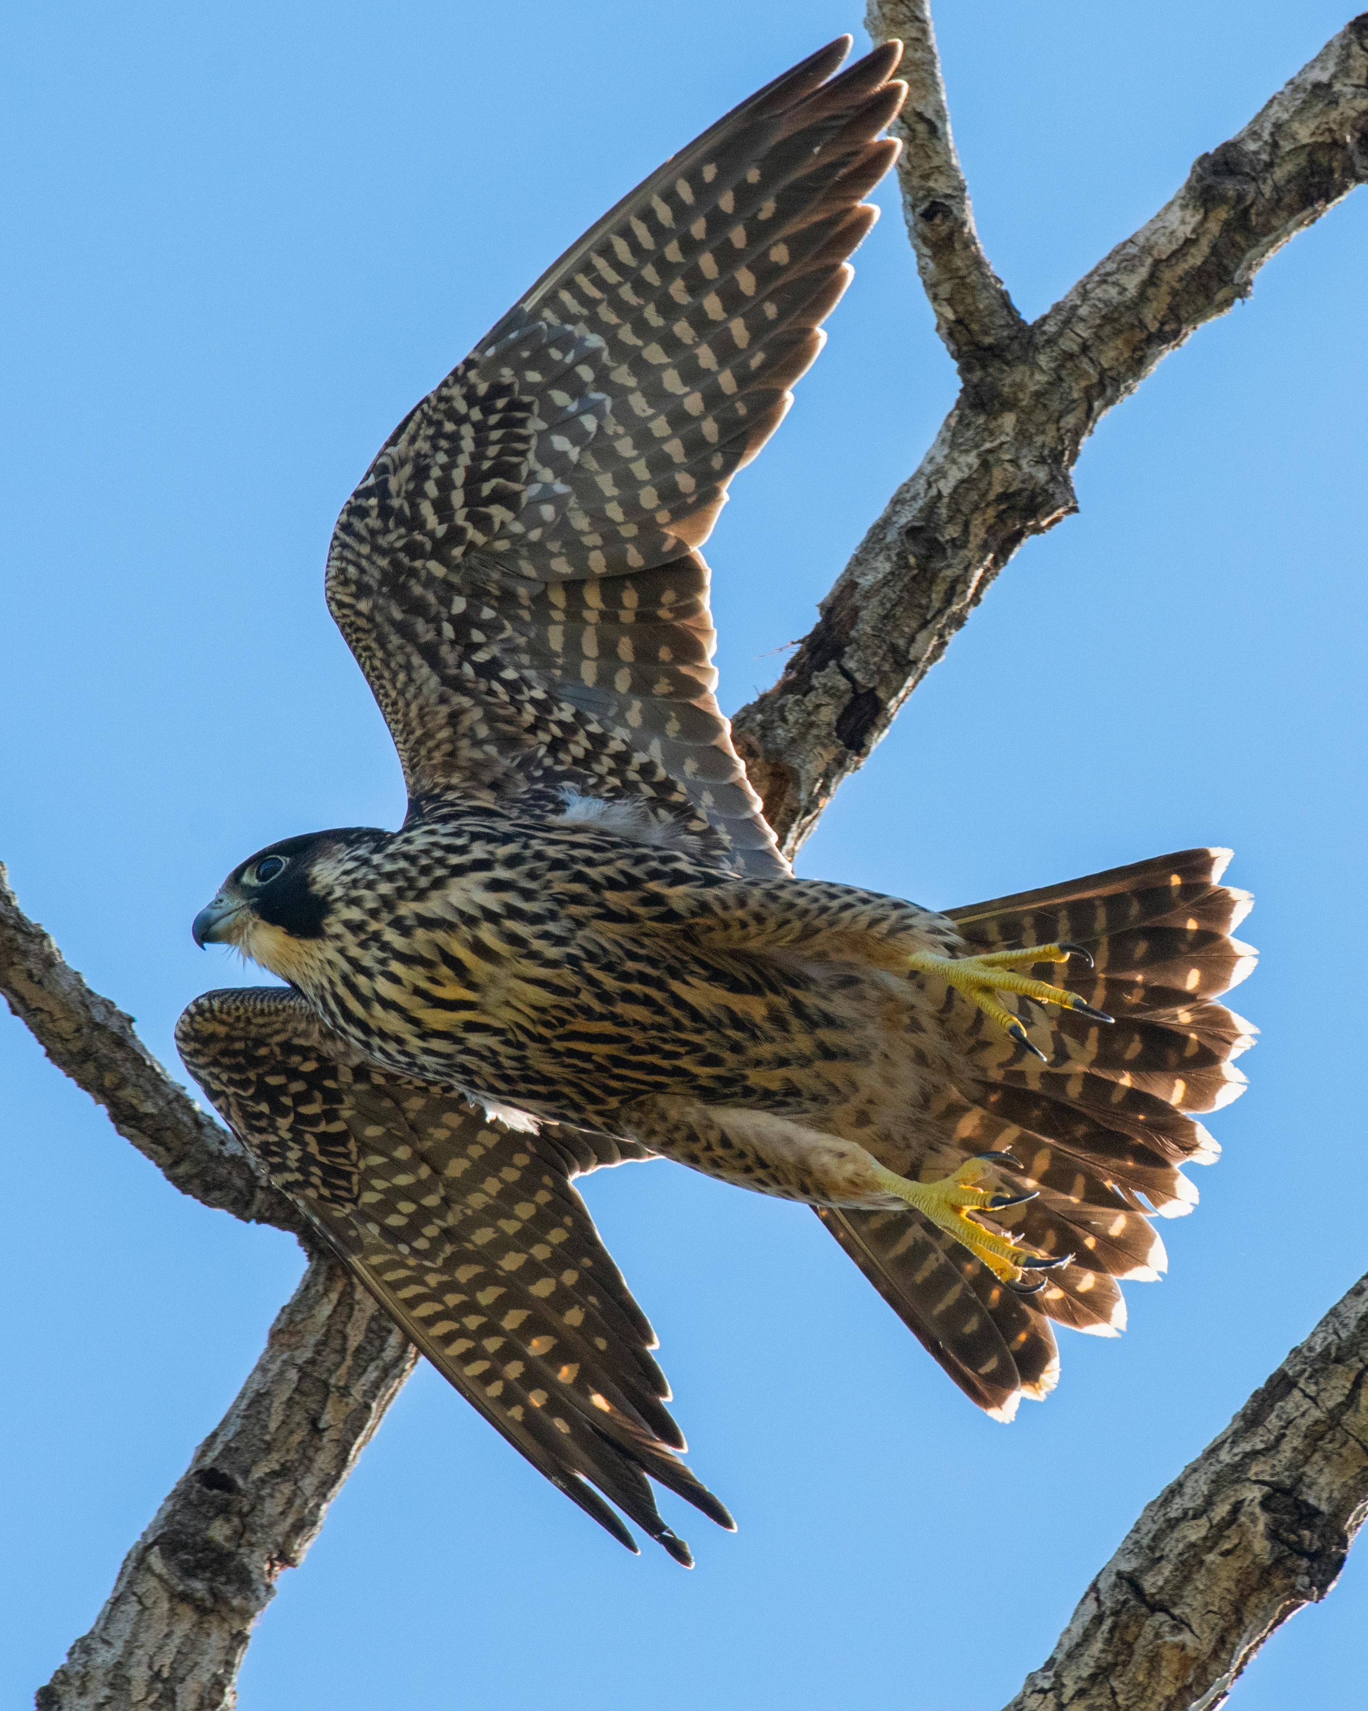
If the bats in the area died out…
What would happen to the corn earworm moths?
How might the peregrine falcon be impacted?
What would happen to the corn plants?
corn earworm, moth, back_2014-06-06-15.37.55 ZS PMax from
USGS Bee Inventory and Monitoring Lab pn Flickr PDM 1.0 DEED
Photo by Markus Spiske from Pexels
Photo by Frank Cone from Pexels
MEXICAN FREE-TAILED BATS
Notes:
Image Sources:
corn earworm, moth, back_2014-06-06-15.37.55 ZS PMax from USGS Bee Inventory and Monitoring Lab on Flickr PDM 1.0 DEED
Corn photo by Markus Spiske from Pexels
Peregrine falcon photo by Frank Cone from Pexels

