Slide 1

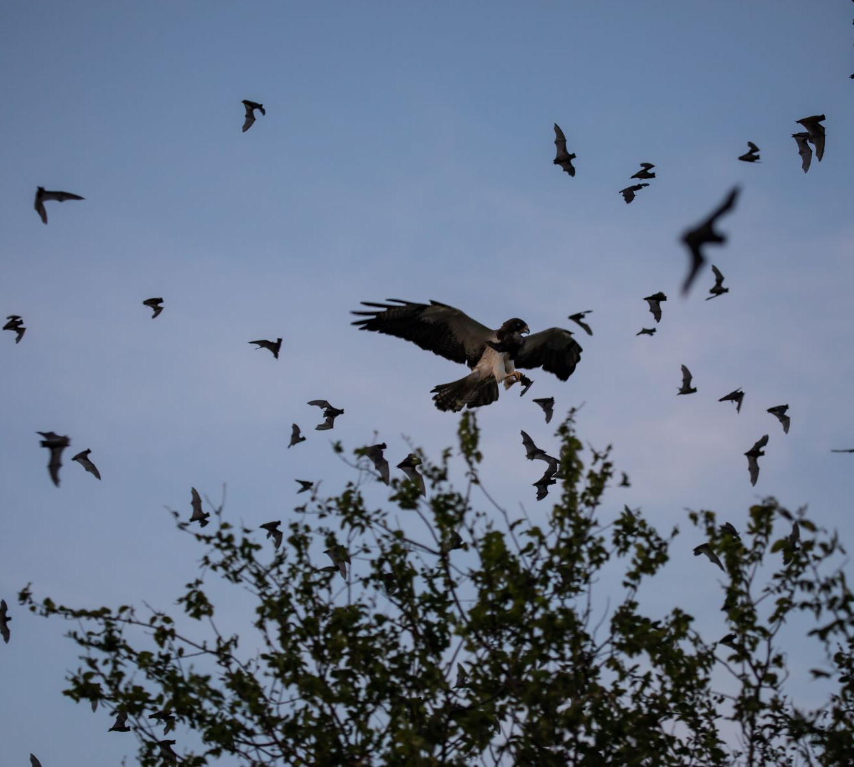
Mexican Free-Tailed Bats
Grades 6 – 8
Biodiversity & Ecological Relationships
Image: Fin & Fur Films Productions
Notes:
A bird of prey hunts Mexican free-tailed bats near Bracken Cave in Texas. Image: Fin & Fur Films Productions

Slide 2


Engage
Bat Facts or Bat Myths?
MEXICAN FREE-TAILED BATS

Slide 3
Bat Facts or Bat Myths?
 | Fact | Myth
1. Bats are blind.
2. All bats drink blood.
3. Bats will fly into your hair
4. All bats have rabies.
5. Bats are not that important.
6. Bats are “vermin” and should be exterminated.
7. Bats are flying mice.
8. All bats are the same.
MEXICAN FREE-TAILED BATS

Slide 4
Explore 1
Mexican Free-Tailed Bats & Bracken Cave
MEXICAN FREE-TAILED BATS

Slide 5
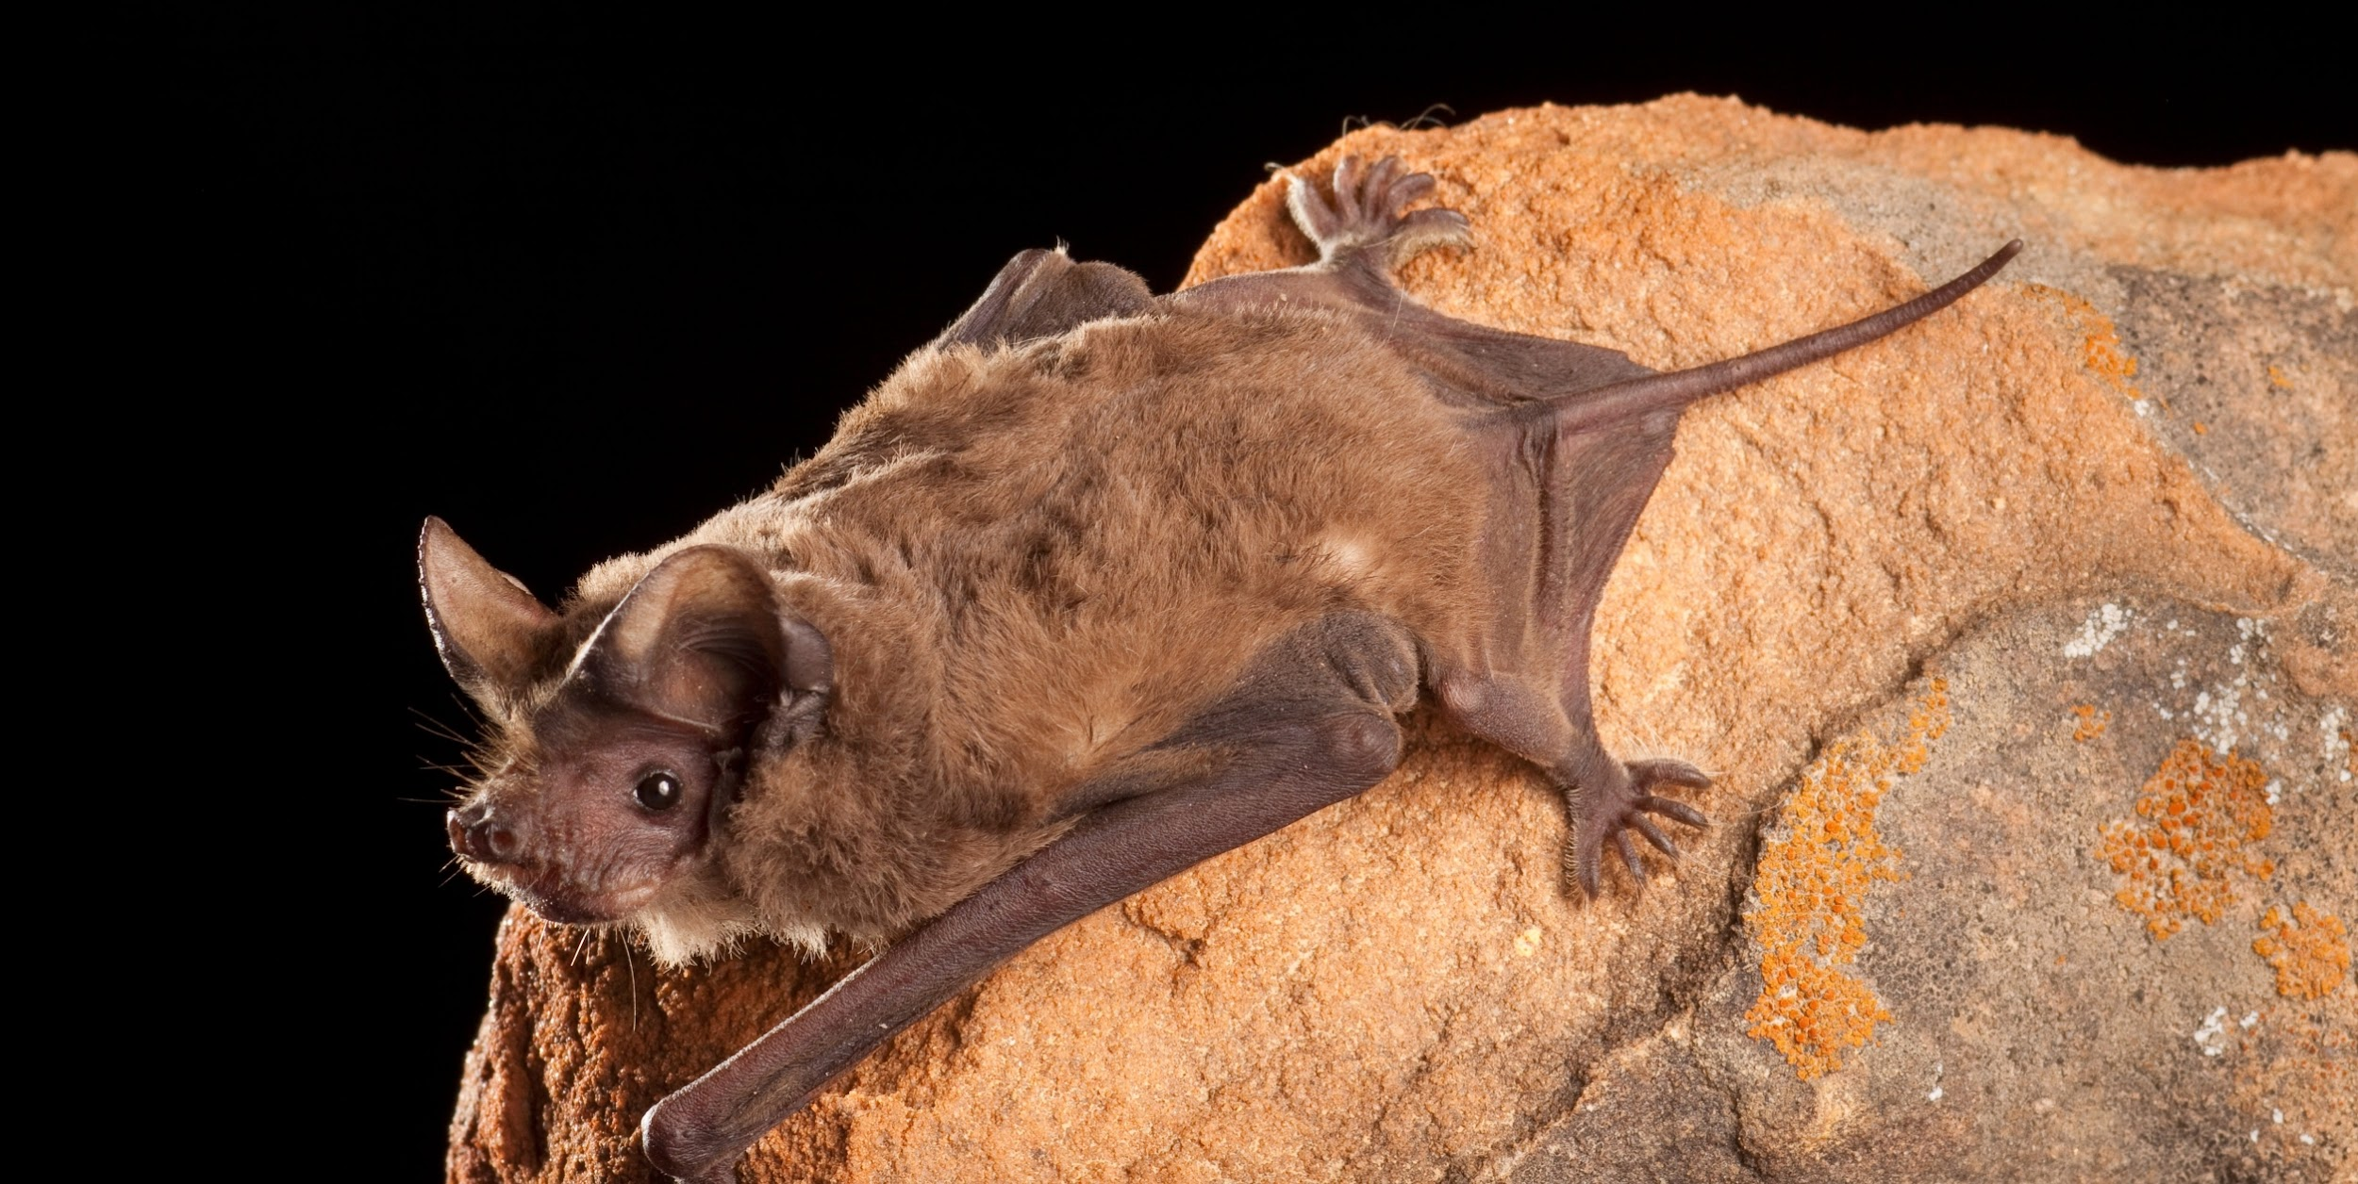
Image: Bat Conservation International 106653-19-2508x1260 https://www.batcon.org/bat/tadarida-brasiliensis/
MEXICAN FREE-TAILED BATS
Notes:
Mexican free-tailed bat image: Bat Conservation International 106653-19-2508x1260 https://www.batcon.org/bat/tadarida-brasiliensis/

Slide 6
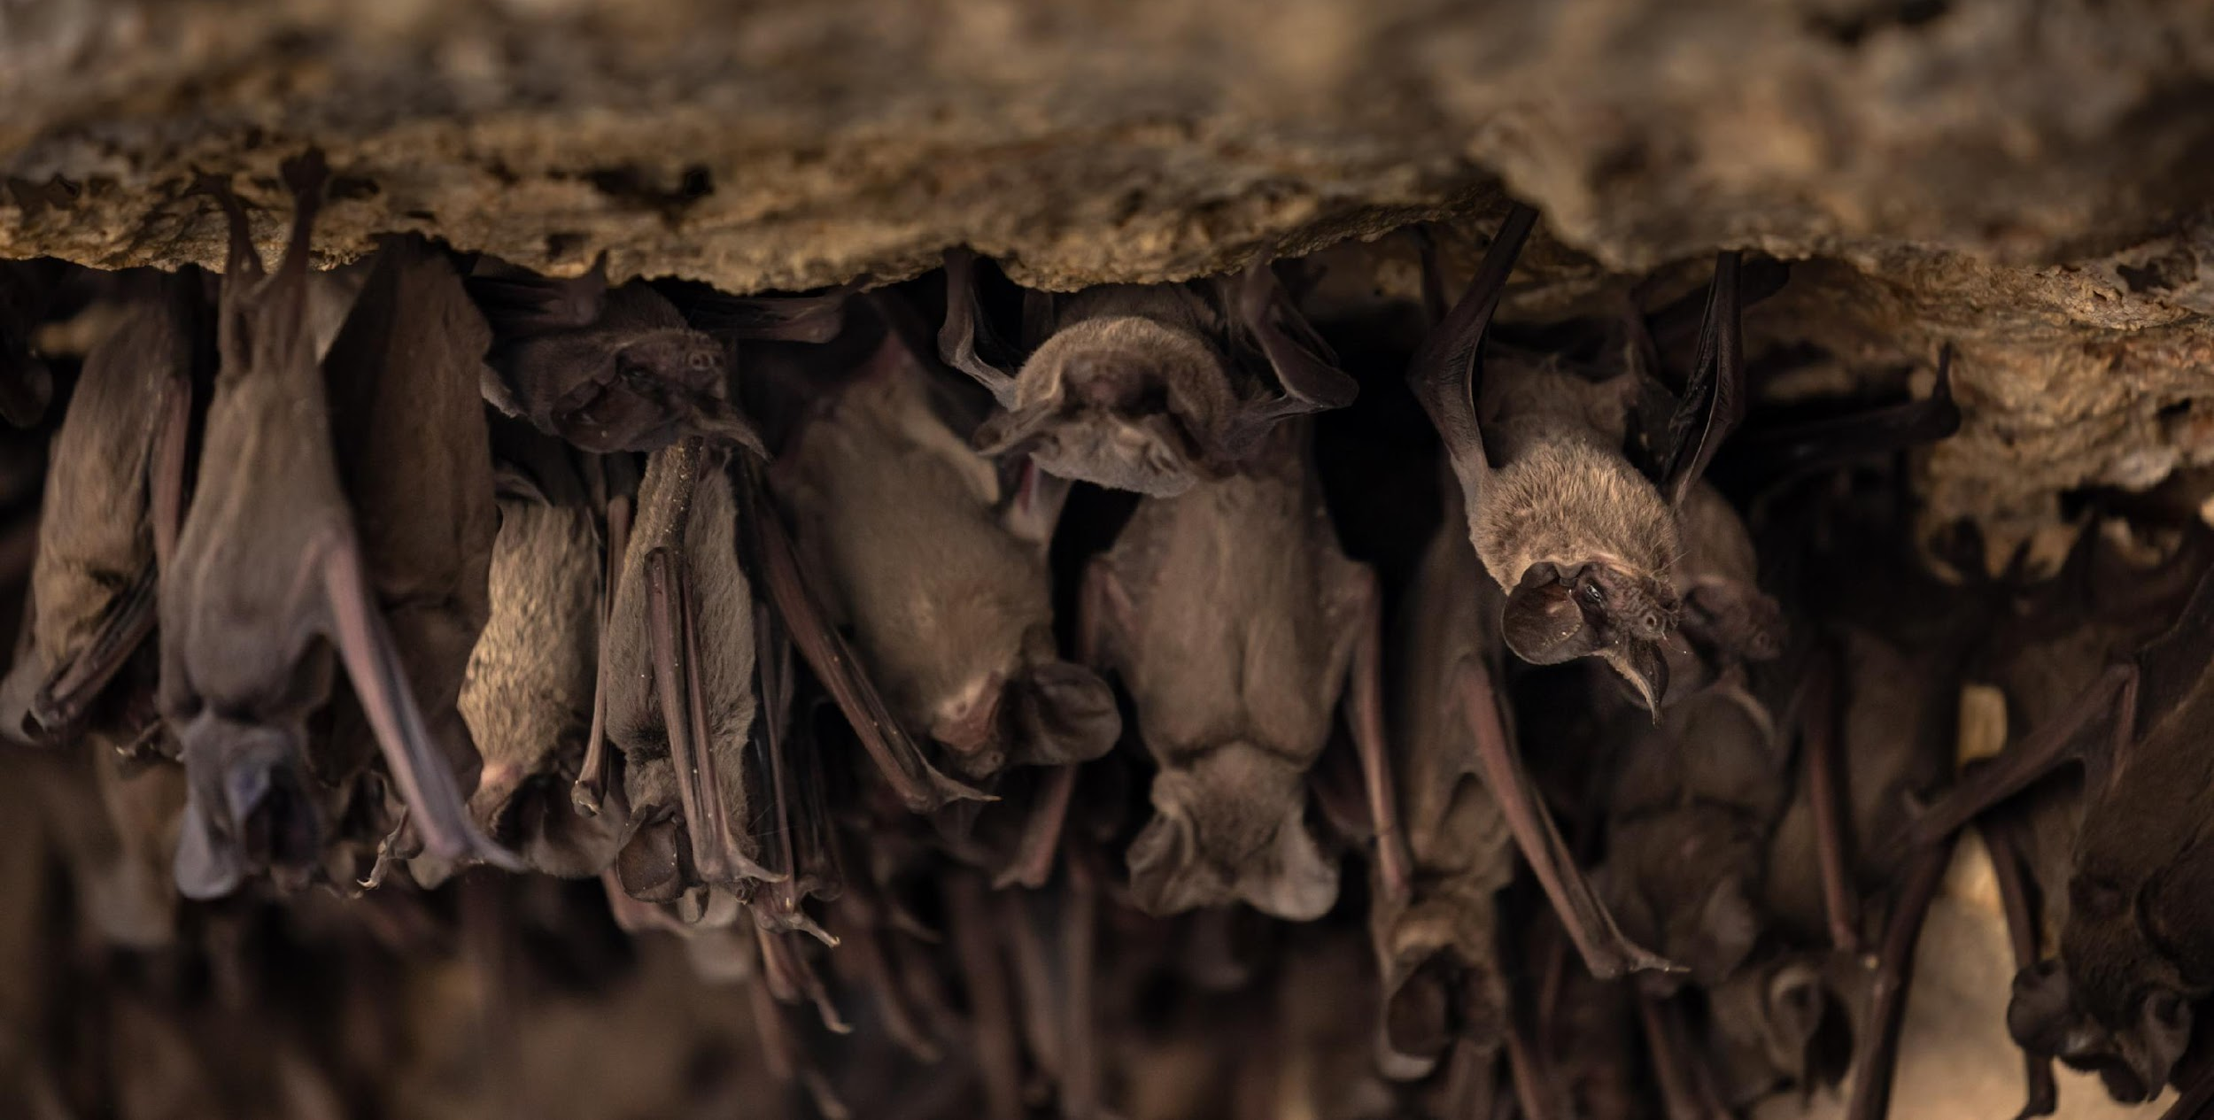
Image: Fin & Fur Films Productions
MEXICAN FREE-TAILED BATS
Notes:
Mexican free-tailed bats image: Fin & Fur Films Productions

Slide 7
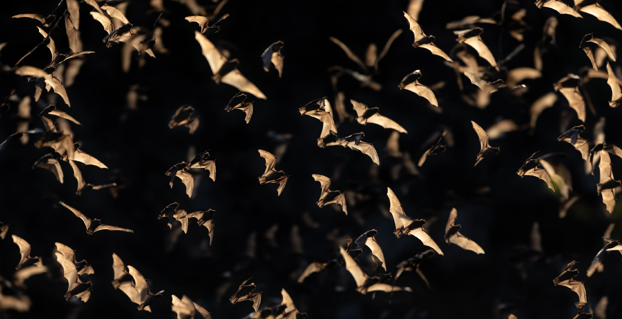
Image: Fin & Fur Films Productions
MEXICAN FREE-TAILED BATS
Notes:
Mexican free-tailed bats image: Fin & Fur Films Productions

Slide 8
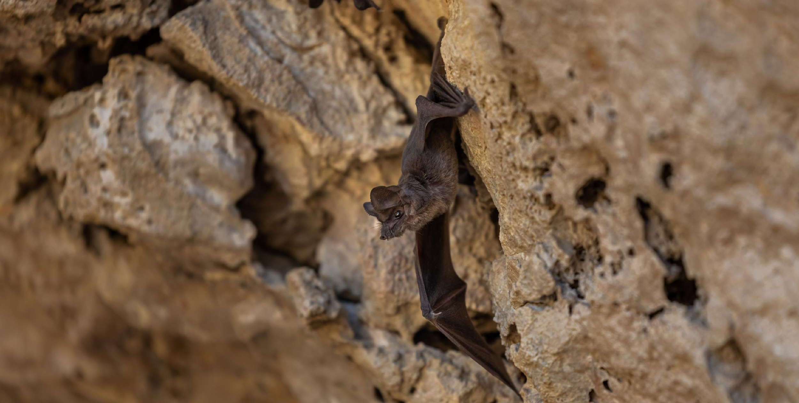
Image: Fin & Fur Films Productions
MEXICAN FREE-TAILED BATS
Notes:
Mexican free-tailed bat image: Fin & Fur Films Productions

Slide 9
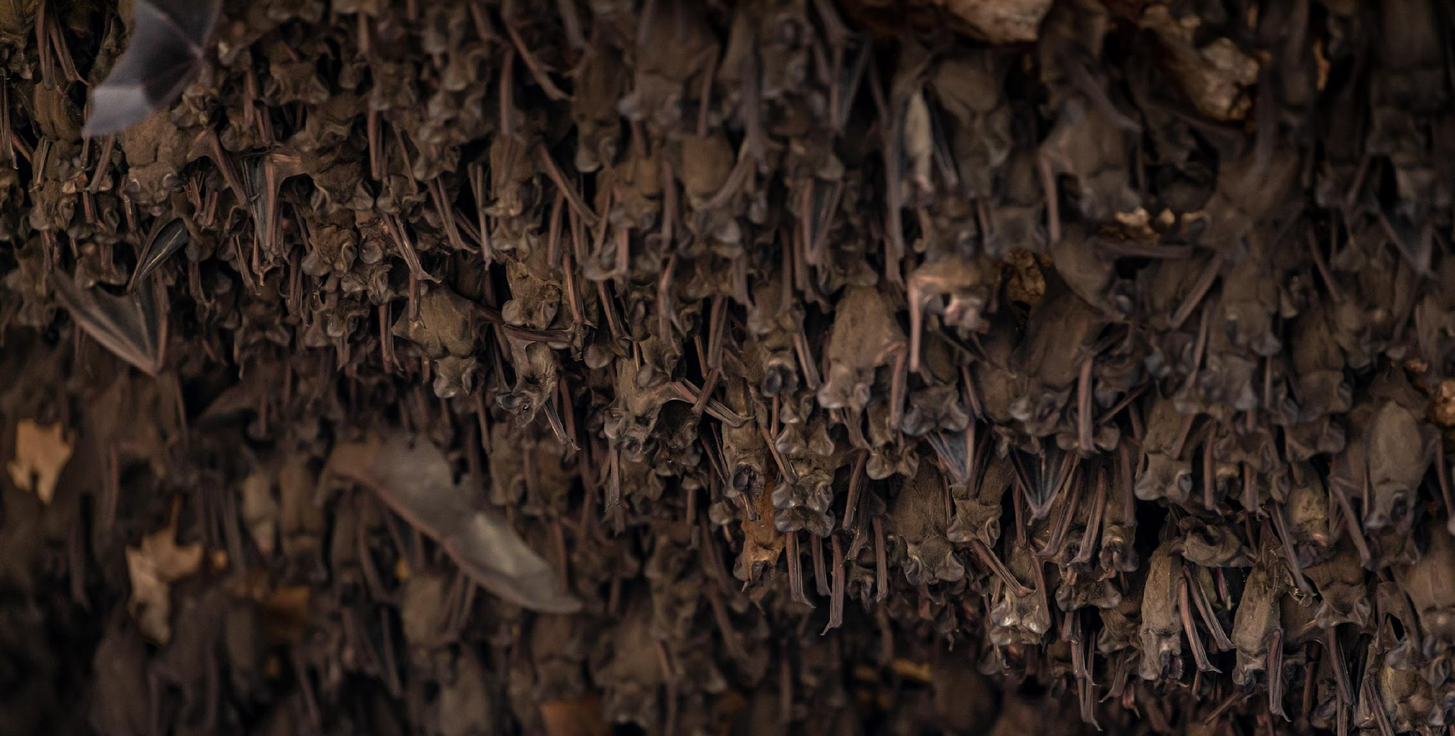
Image: Fin & Fur Films Productions
MEXICAN FREE-TAILED BATS
Notes:
Mexican free-tailed bats image: Fin & Fur Films Productions

Slide 10
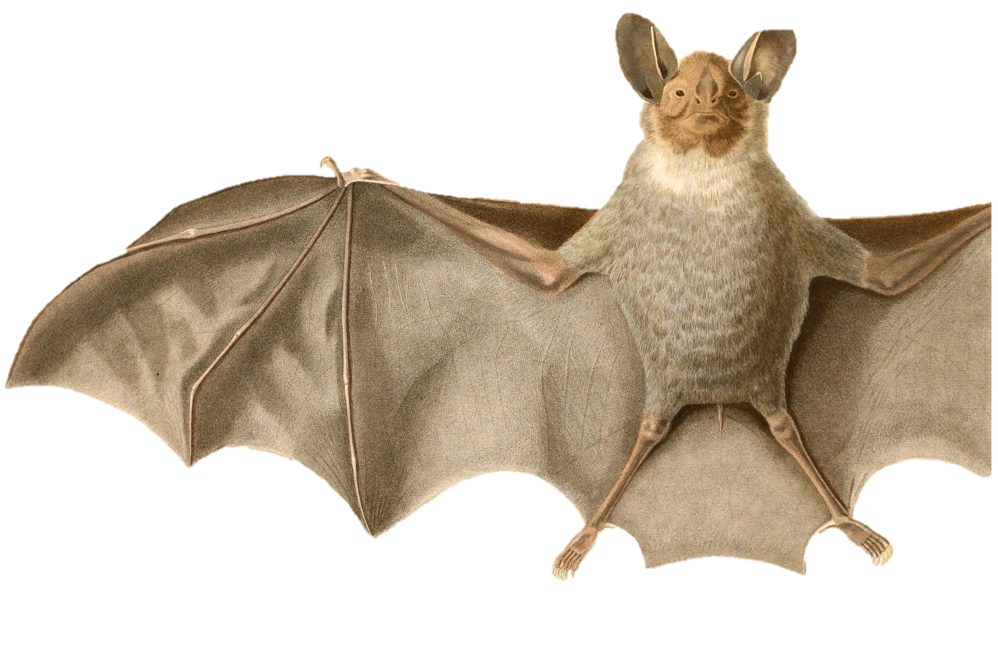
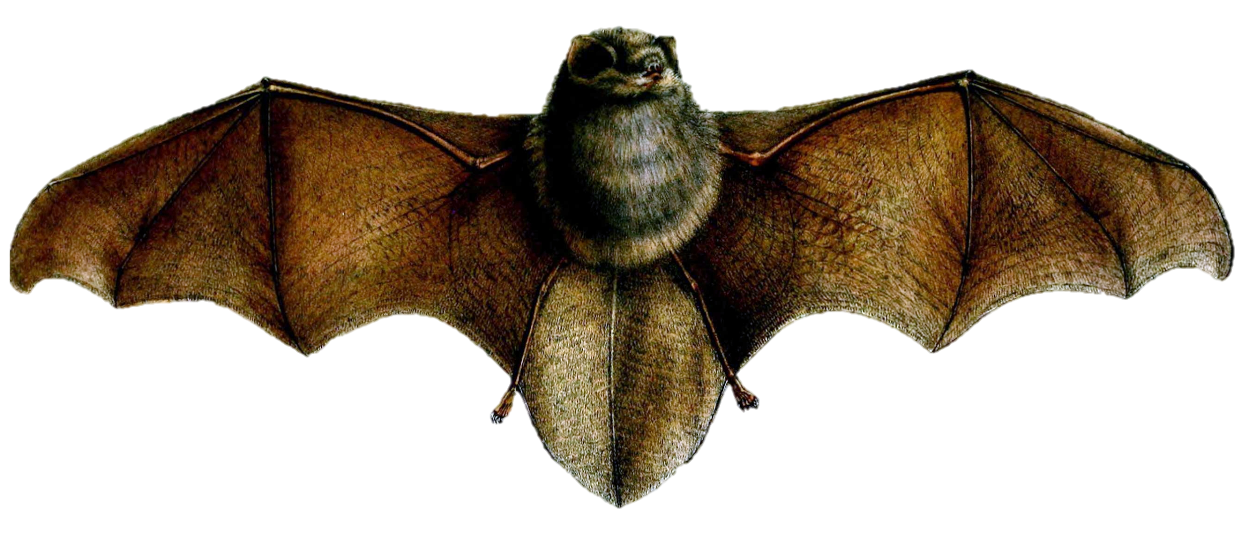
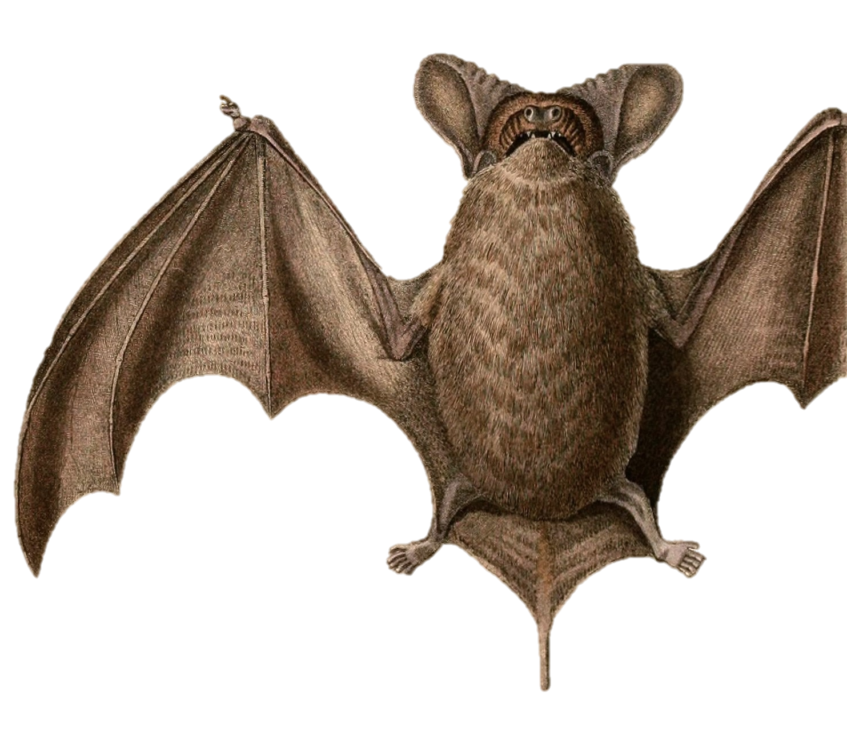
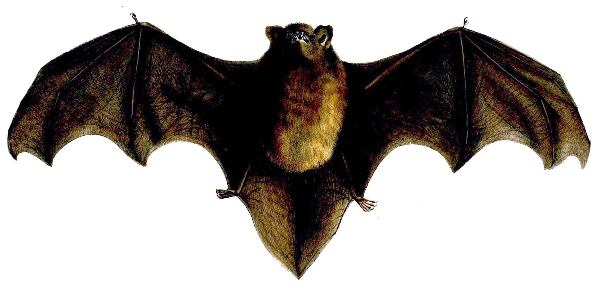
What do you notice about these bats’ tails?
Thumbless Bat
White-Throated
Round-Eared Bat
New Zealand
Long-Tailed Bat
Why do you think
Mexican free-tailed bats have
“free-tailed” in their name?
Mexican Free-Tailed Bat
Notes:
Image Sources:
Tadarida brasiliensis brasiliensis (Subspecies of Mexican Free-tailed Bat) by Alcide Dessalines. Public Domain, https://commons.wikimedia.org/w/index.php?curid=20018017
Thumbless Bat by G.H.Ford - Proceedings of the Zoological Society of London (vol. 1856, plate Mammalia XLII), Public Domain, https://commons.wikimedia.org/w/index.php?curid=60271758
New Zealand long-tailed bat Scotophilus tuberculatus By GH Ford - Proceedings of the Zoological Society of London 1857 (web), Public Domain, https://commons.wikimedia.org/w/index.php?curid=15263264
Lophostoma silvicolum (White-throated Round-eared Bat) by Alcide Dessaline. Public Domain, https://commons.wikimedia.org/w/index.php?curid=20017135

Slide 11
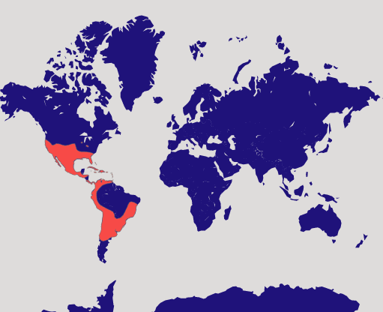
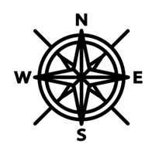
Map: Bat Conservation International https://www.batcon.org/bat/tadarida-brasiliensis/
Do Mexican free-tailed bats live in your area?
Map Key
Mexican free-tailed
bats live here.
Notes:
Mexican free-tailed bats live in the southern part of North America, Central America, and parts of South America.
Map Source: Bat Conservation International https://www.batcon.org/bat/tadarida-brasiliensis/
Compass Rose by imaginationlol on Flaticon https://www.flaticon.com/free-icon/wind-rose_4031900?term=compass+rose&page=1&position=2&origin=search&related_id=4031900

Slide 12
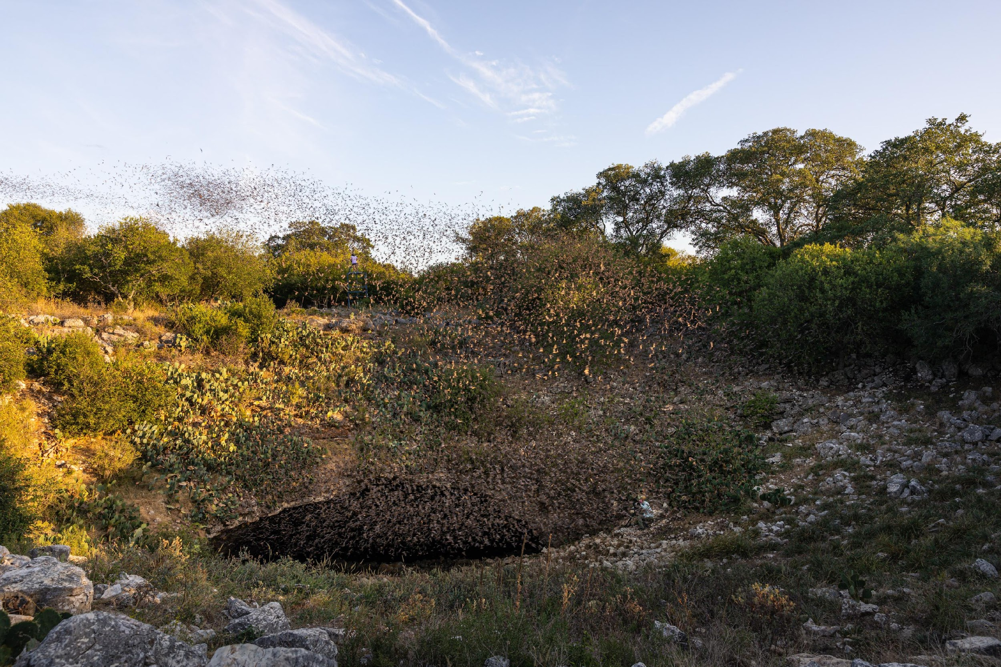
Image: Fin & Fur Films Productions
MEXICAN FREE-TAILED BATS
Notes:
Mexican free-tailed bats at Bracken Cave in Texas image: Fin & Fur Films Productions

Slide 13
Image: Fin & Fur Films Productions
MEXICAN FREE-TAILED BATS
Notes:
Mexican free-tailed bats image: Fin & Fur Films Productions

Slide 14
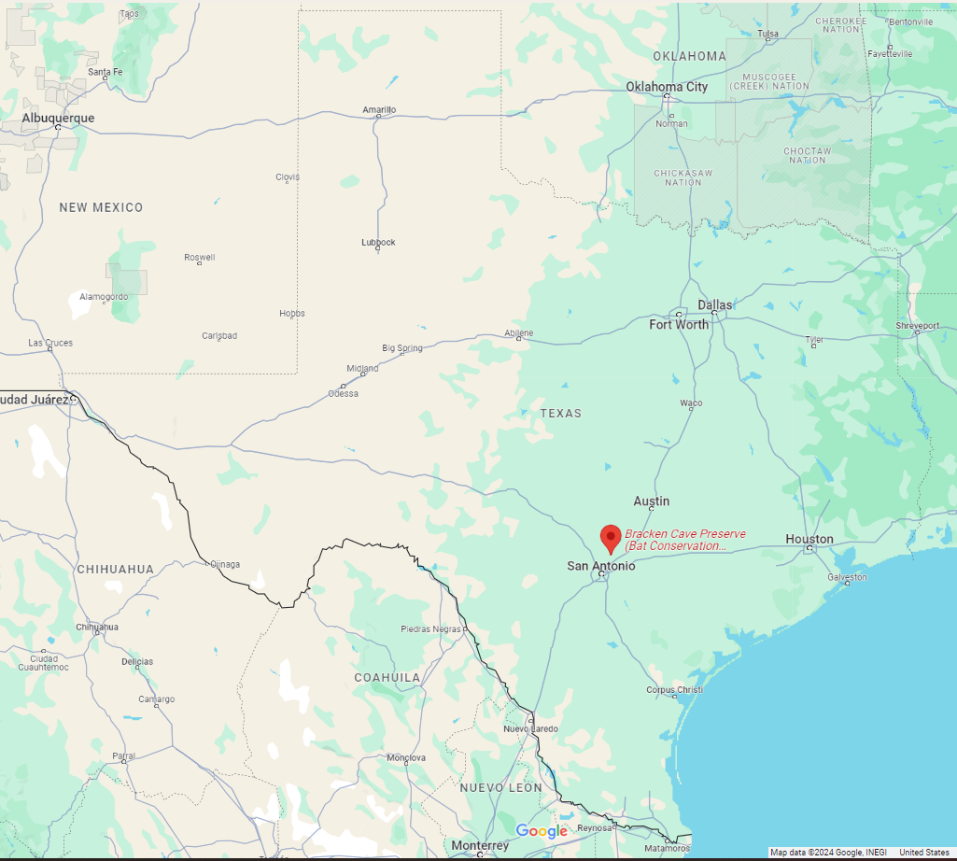
Bracken Cave
What large city is closest to Bracken Cave?
How long would it take you to get to Bracken Cave?
Have you heard of Bracken Cave before?
Have you visited the cave yet?
Notes:
Bracken Cave is located on the northern outskirts of San Antonio.
Map Source: Google Maps
Compass Rose by imaginationlol on Flaticon https://www.flaticon.com/free-icon/wind-rose_4031900?term=compass+rose&page=1&position=2&origin=search&related_id=4031900

Slide 15
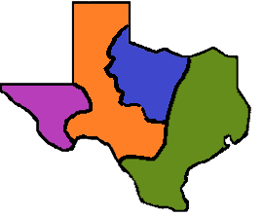
*This map roughly estimates the location of Bracken Cave Preserve. This map is not to scale.
Bracken Cave is located in Bracken Cave Preserve which spans 1,400+ acres.
Great
Plains
Central Plains
Mountains & Basins
Coastal Plains
Bracken Cave Preserve
Which physical region(s) of Texas is Bracken Cave Preserve located in?
Notes:
Map Source: Fin & Fur Films Productions
Compass Rose by imaginationlol on Flaticon https://www.flaticon.com/free-icon/wind-rose_4031900?term=compass+rose&page=1&position=2&origin=search&related_id=4031900

Slide 16
Explore 2
Biodiversity
MEXICAN FREE-TAILED BATS

Slide 17
Biodiversity
MEXICAN FREE-TAILED BATS
Notes:
Tell students they will explore the biodiversity in and around Bracken Cave. Use the following question to gauge students’ current understanding of biodiversity:
a. Ask, “What do you notice about the word biodiversity?”
Students may notice “bio” and “diversity” in the word. Ask students to explain if they have heard the word bio used on its own or as a prefix. Responses could include using “bio” to mean biography or a short, written profile of someone. Students may have also heard the term “bio break.” Some words with the prefix bio include biology, biography, biosphere, and biotic (just to name a few).
Ask how students have heard the word diversity used before. For example, students may be familiar with the phrase “diversity, equity, and inclusion” (DEI).
b. Ask, “What does bio mean?” Bio means relating to life.
c. Ask, “What does diversity mean?” Diversity means being diverse. Diverse means a great deal of variety.
d. Ask, “After looking at those two parts of the word, what do you think biodiversity means?”

Slide 18
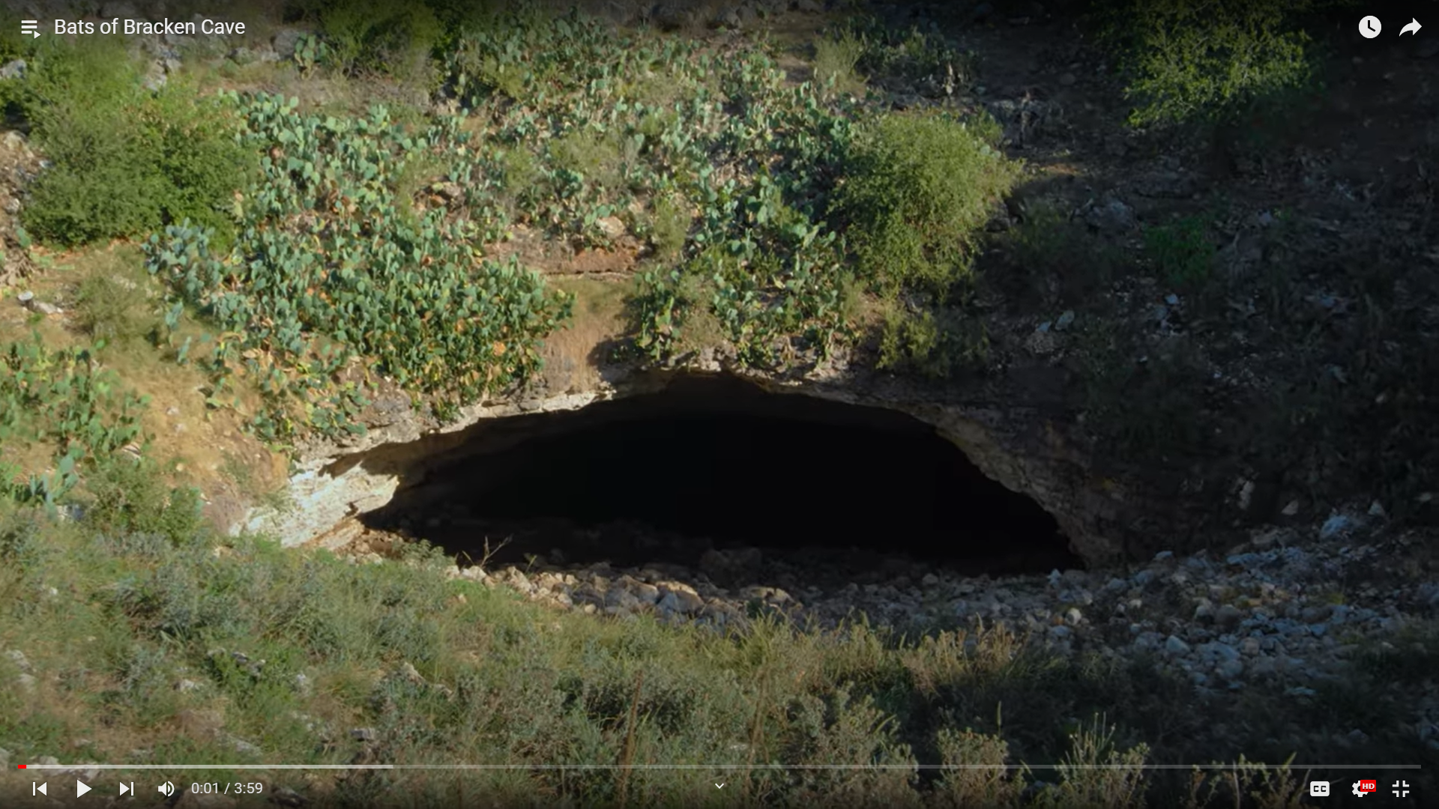
Notes:
Deep in the Heart Bats of Bracken Cave This video is also available on YouTube: https://youtu.be/H-q58Jd50Lk?si=1j1TePoUr2TrAiua (4 minutes.)

Slide 19
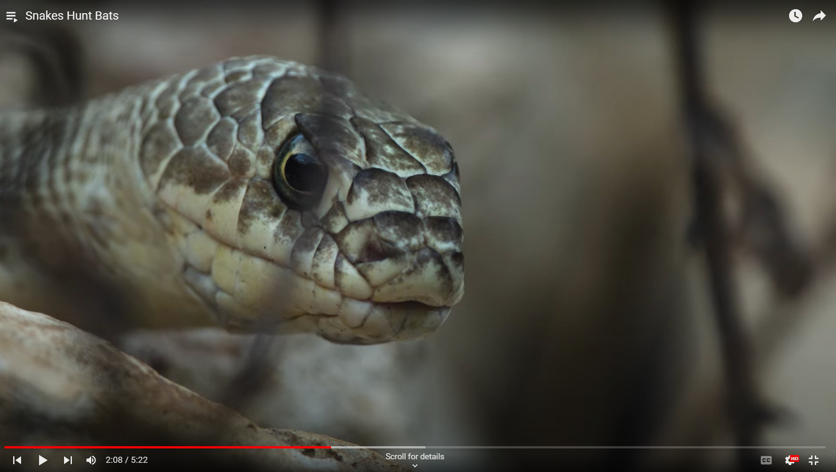
Notes:
Deep in the Heart Snakes Hunt Bats This video is also available on YouTube: https://youtu.be/60Zf7-hLS4E?si=RmHjTr73O0oyXQCS (5 minutes)

Slide 20
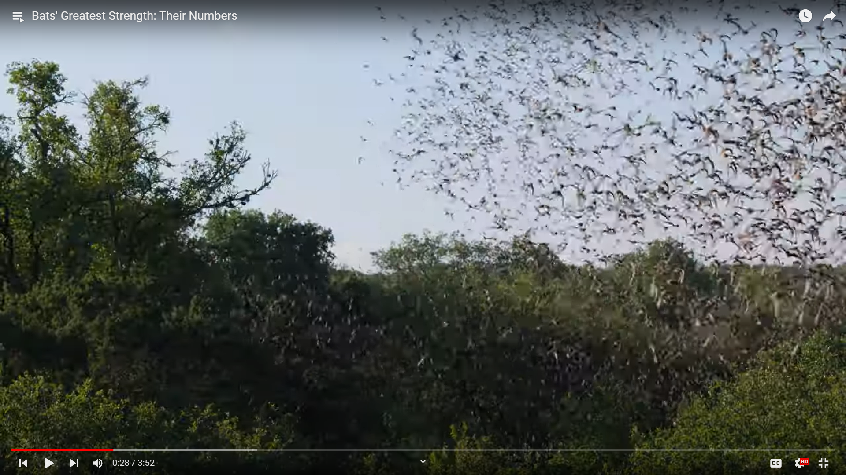
Notes:
Deep in the Heart Bats' Greatest Strength: Their Numbers This video is also available on YouTube: https://youtu.be/Va7otBnHq_s?si=lZjAKVvxg2ujWA60 (4 minutes)

Slide 21
Explore 3
Ecological Relationships & Sustainability
MEXICAN FREE-TAILED BATS

Slide 22
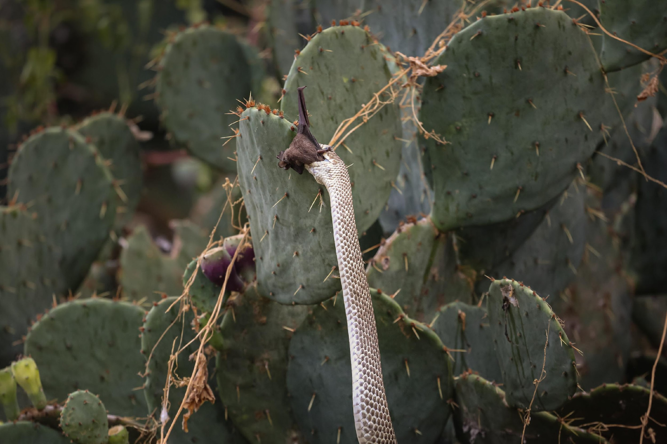
predator
Predatory Relationship
one organism (the predator) hunts and eats another
organism (the prey)
prey
Image: Fin & Fur Films Productions
MEXICAN FREE-TAILED BATS
Notes:
Coachwhip snake captures a Mexican free-tailed bat near Bracken Cave in Texas image: Fin & Fur Films Productions

Slide 23
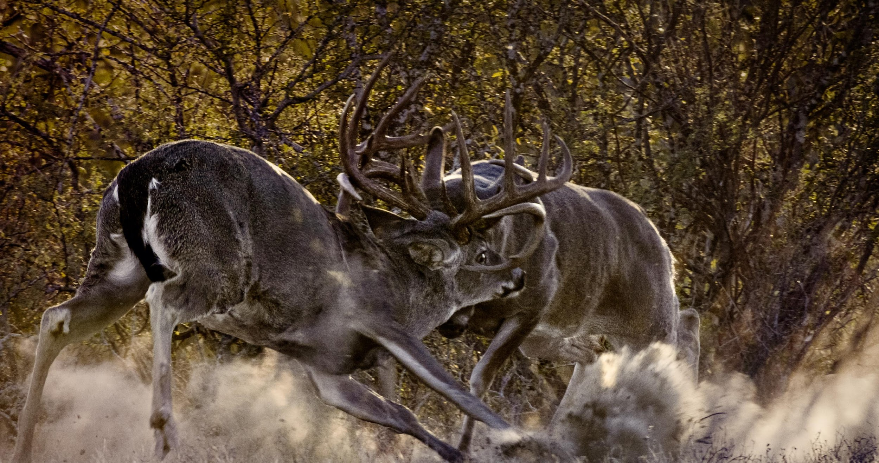
Competitive Relationship
occurs when two or more organisms need the same limited resources to survive & reproduce within an ecosystem
competition can happen between organisms of the same species & among members of different species
Image: Fin & Fur Films Productions
MEXICAN FREE-TAILED BATS
Notes:
White-tailed deer image: Fin & Fur Films Productions

Slide 24
Symbiotic Relationship
a close, prolonged (lengthy) association between two or more different species
MEXICAN FREE-TAILED BATS

Slide 25
Symbiotic Relationships
close, prolonged (lengthy) associations between
two or more different species
Mutualism (+/+) - a symbiotic relationship between two species in which both benefit
Commensalism (+/0) - a symbiotic relationship between two species in which one benefits, and the other is unaffected
Parasitism (+/-) - a symbiotic relationship between two species in which one benefits, and the other is harmed
MEXICAN FREE-TAILED BATS

Slide 26
Ecosystem Sustainability
MEXICAN FREE-TAILED BATS

Slide 27
A sustainable ecosystem can remain consistent over time despite disturbances and stressors.
Disturbances are natural events like storms & fires.
Stressors are caused by human activity like building a highway & pollution.
High biodiversity supports a sustainable ecosystem because if one species in a biologically diverse ecosystem declines, other organisms can fill the declining organism’s roles.
Tell your partner what each of the BOLD phrases means in your own words.
As you and your partner work together, write down at least 1 question you have. Or write down at least 1 question you think a classmate might have about these ideas.
Sources:
Tutor Chase. (n.d.) Explain the concept of a stable ecosystem. https://www.tutorchase.com/answers/ib/biology/explain-the-concept-of-a-stable-ecosystem
U.S. Department of Agriculture. (n.d.). Disturbances and Stressors. Climate Hubs. https://www.climatehubs.usda.gov/disturbances-and-stressors
MEXICAN FREE-TAILED BATS

Slide 28
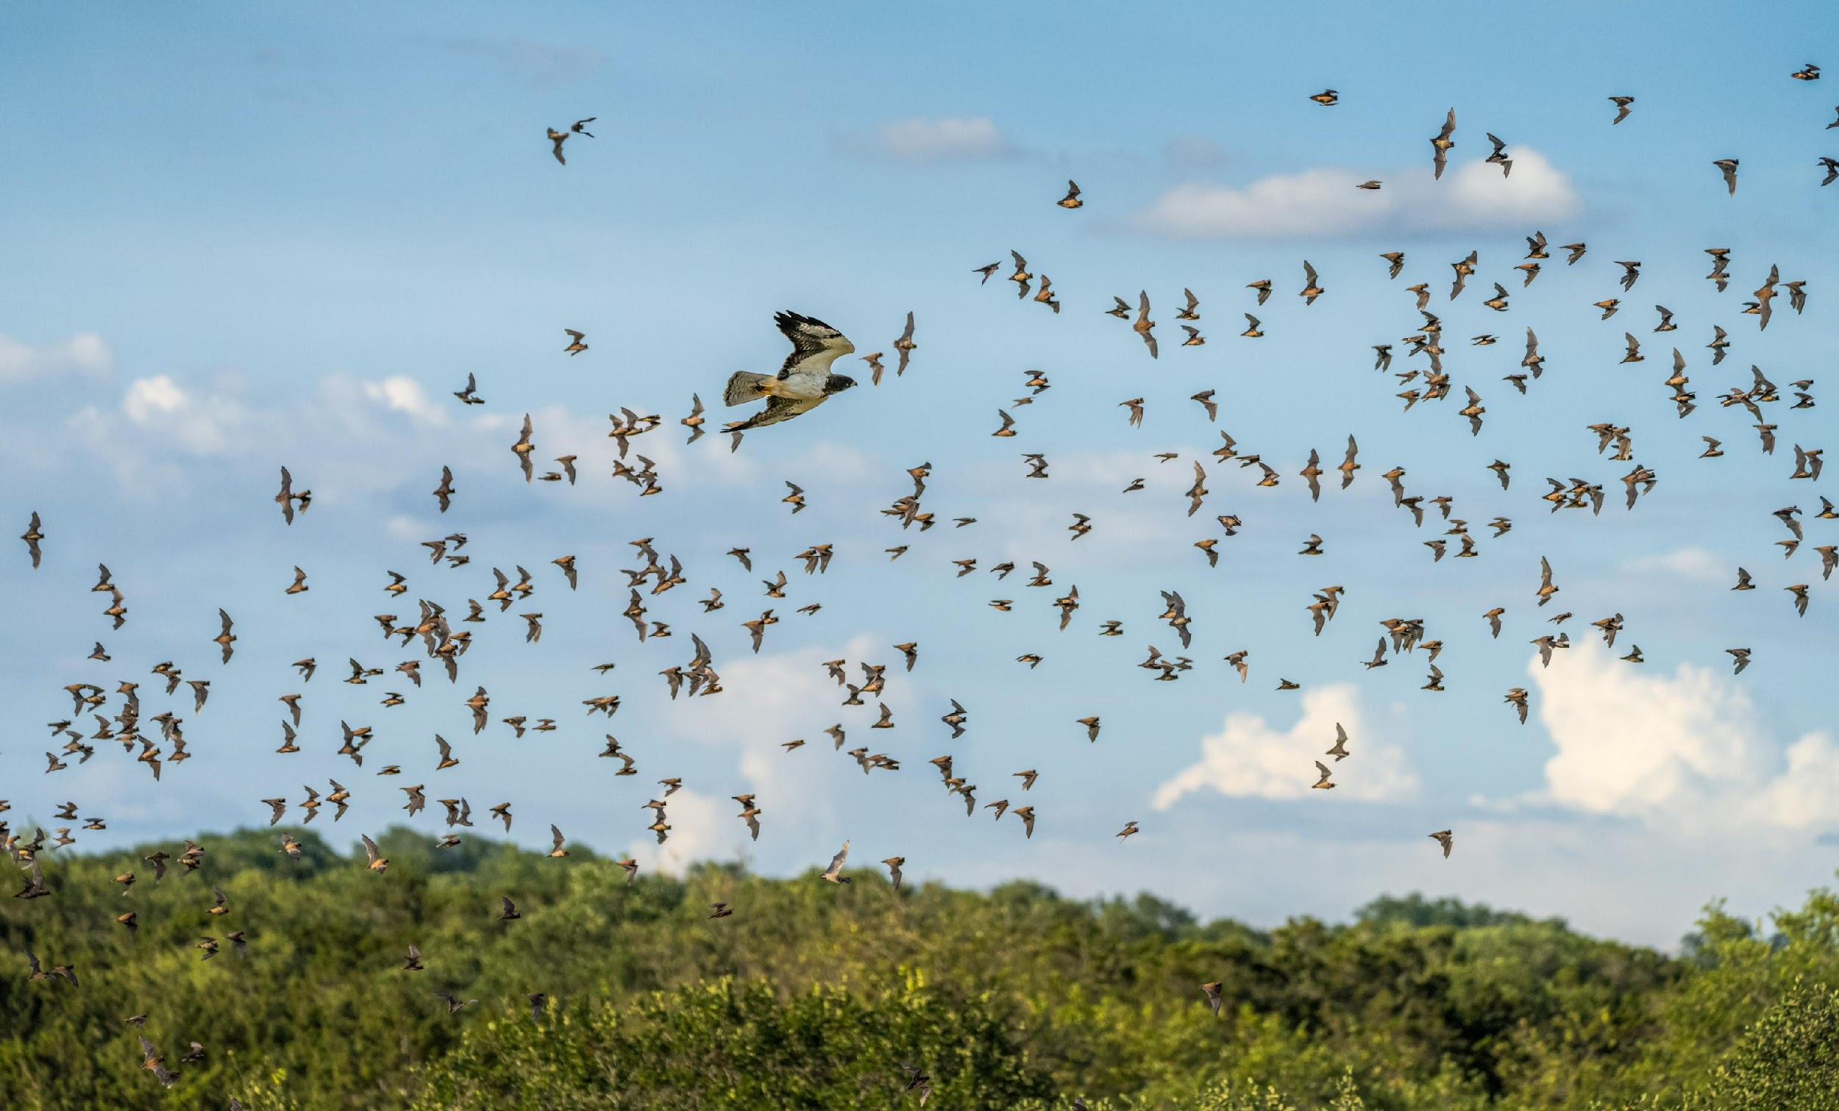
Do you think the ecosystem in the bat videos is sustainable?
Do you need more info to answer this question?
If so, what info do you need?
Images: Fin & Fur Films Productions
Notes:
Images: Fin & Fur Films Productions
Mexican free-tailed bats at Bracken Cave in Texas
A bird of prey hunts Mexican free-tailed bats near Bracken Cave in Texas.
A coachwhip snake captures a Mexican free-tailed bat near Bracken Cave in Texas.

