Slide 1

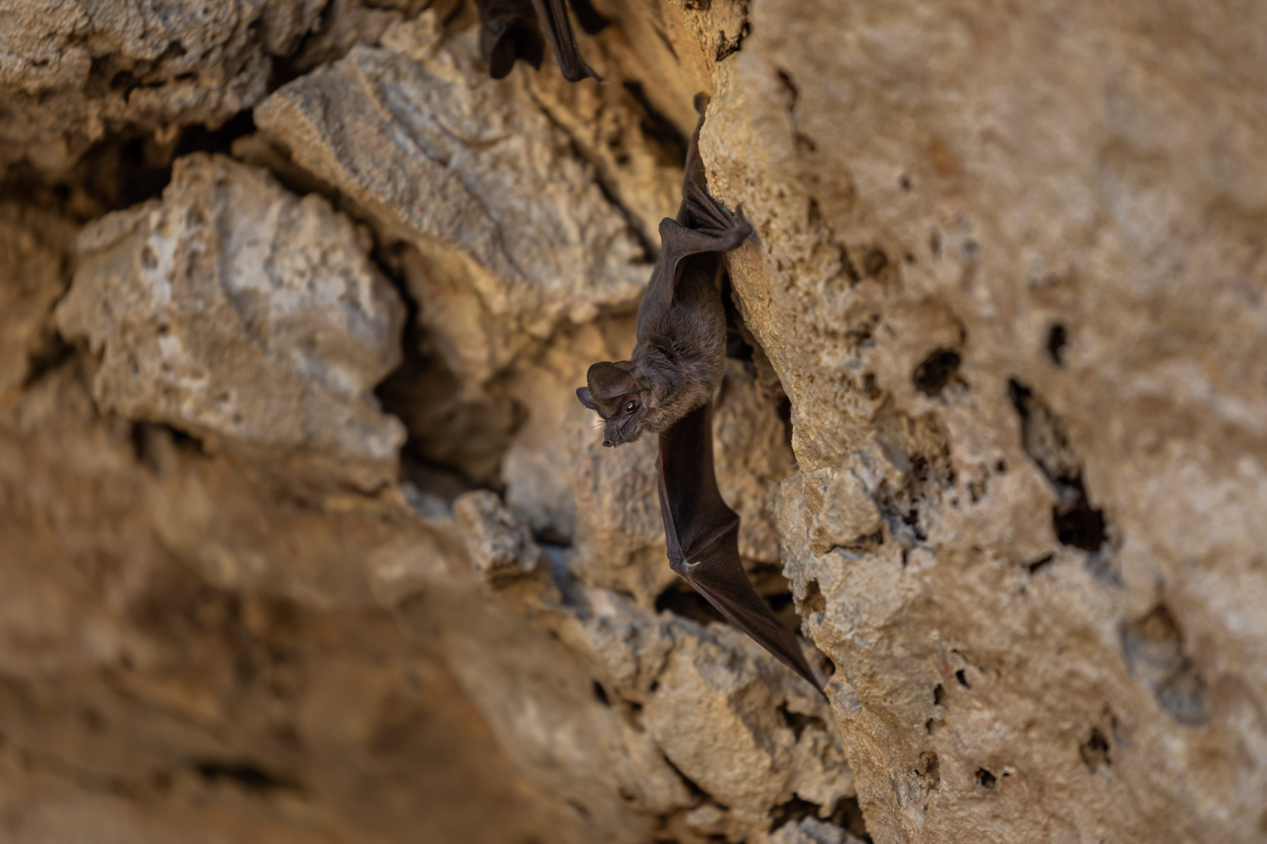
Murciélagos mexicanos de cola libre
Prekinder - Grado 2
Estructuras & Funciones
Image: Fin & Fur Films Productions
Notes:
Mexican free-tailed bat image: Fin & Fur Films Productions

Slide 2
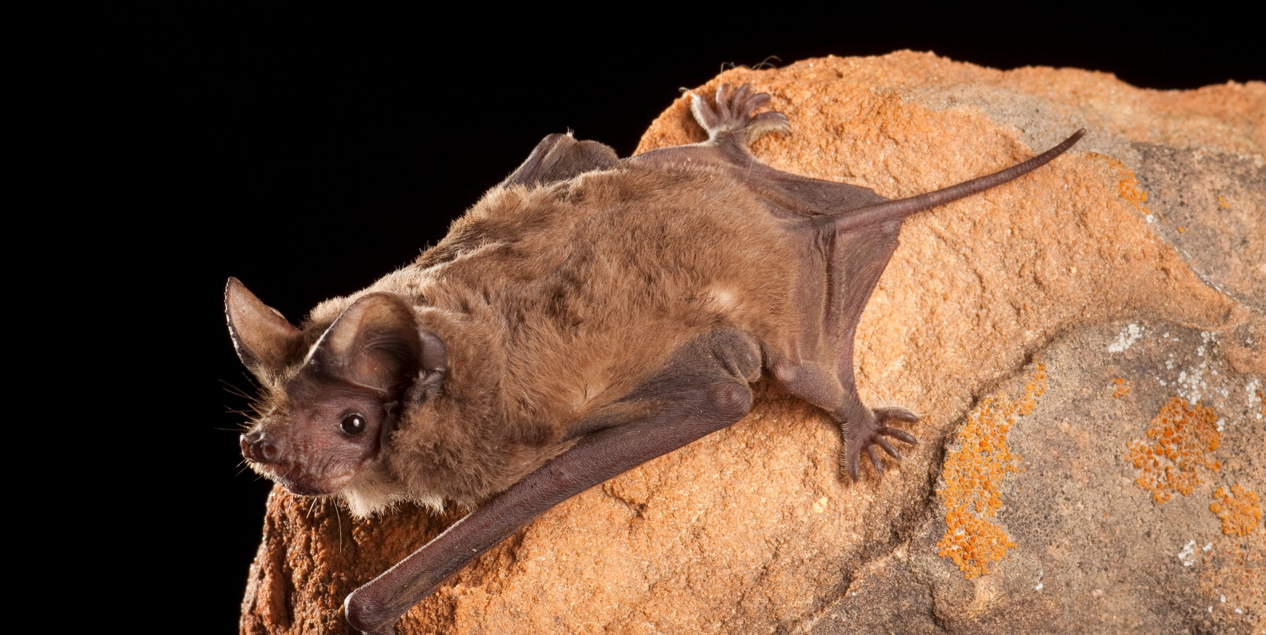
Image: Bat Conservation International 106653-19-2508x1260 https://www.batcon.org/bat/tadarida-brasiliensis/
MURCIÉLAGOS MEXICANOS DE COLA LIBRE
Notes:
Mexican free-tailed bat image: Bat Conservation International 106653-19-2508x1260 https://www.batcon.org/bat/tadarida-brasiliensis/

Slide 3
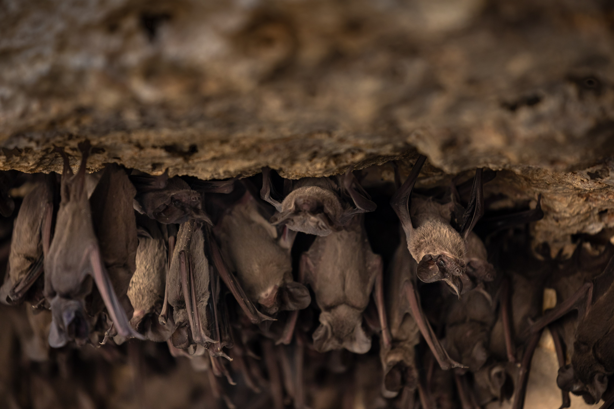
Image: Fin & Fur Films Productions
MURCIÉLAGOS MEXICANOS DE COLA LIBRE
Notes:
Mexican free-tailed bats image: Fin & Fur Films Productions

Slide 4
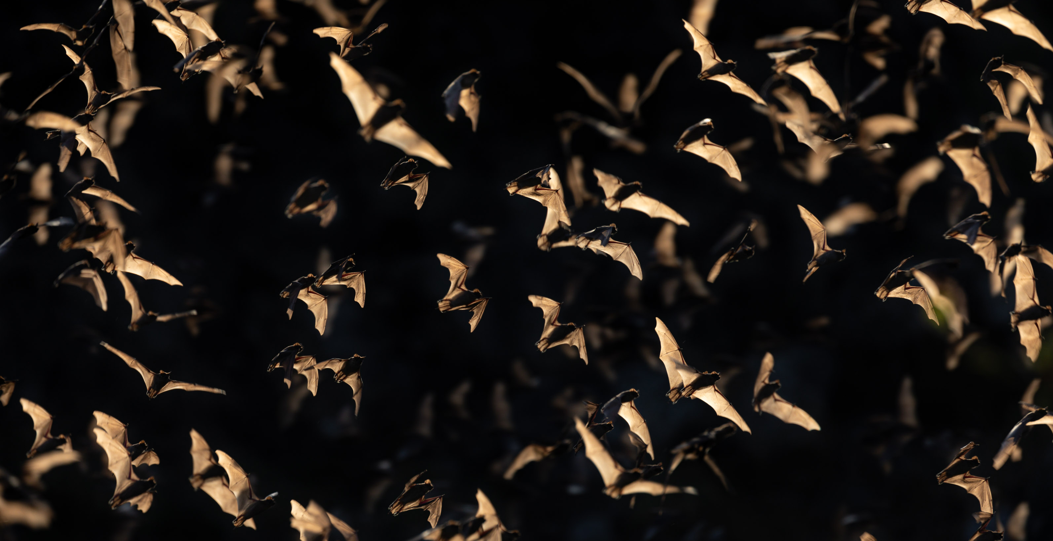
Image: Fin & Fur Films Productions
MURCIÉLAGOS MEXICANOS DE COLA LIBRE
Notes:
Mexican free-tailed bats image: Fin & Fur Films Productions

Slide 5
Image: Fin & Fur Films Productions
MURCIÉLAGOS MEXICANOS DE COLA LIBRE
Notes:
Mexican free-tailed bat image: Fin & Fur Films Productions

Slide 6
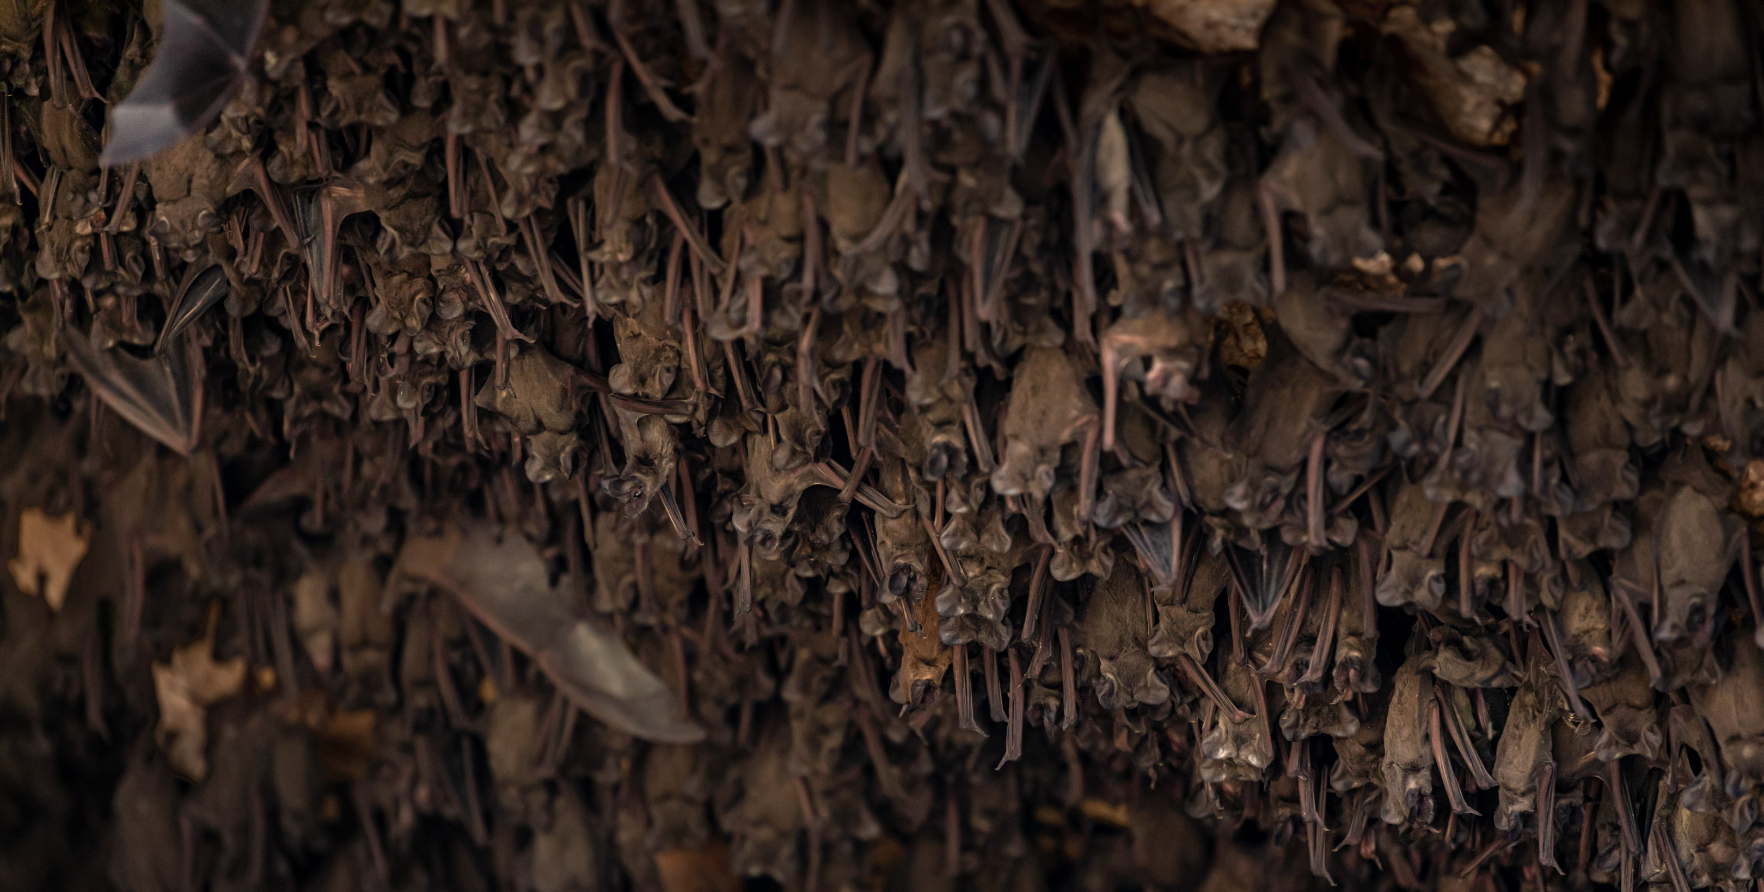
Image: Fin & Fur Films Productions
MURCIÉLAGOS MEXICANOS DE COLA LIBRE
Notes:
Mexican free-tailed bats image: Fin & Fur Films Productions

Slide 7
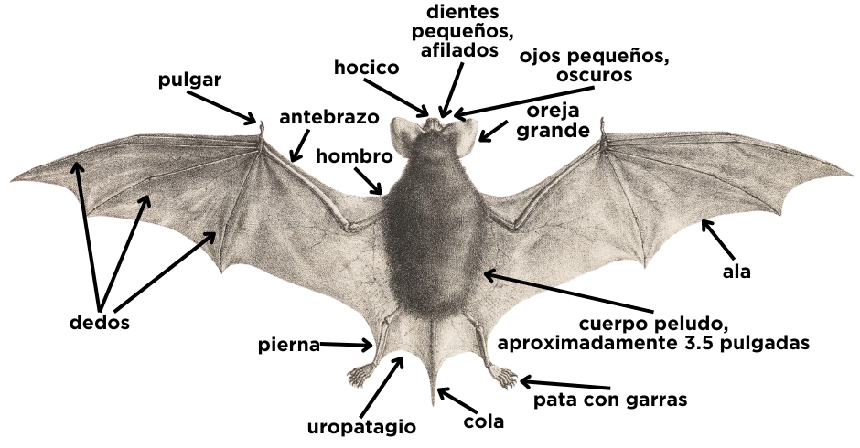
Murciélago mexicano de cola libre
también conocido como Murciélago brasileño de cola libre
Tadarida brasiliensis
Bat Image by Iconographia Zoologica, Public Domain, https://commons.wikimedia.org/w/index.php?curid=55099120, labels added by Deep in the Heart October 2023
Notes:
Bat Image by Iconographia Zoologica, Public Domain, https://commons.wikimedia.org/w/index.php?curid=55099120, labels added by Deep in the Heart October 2023

Slide 8
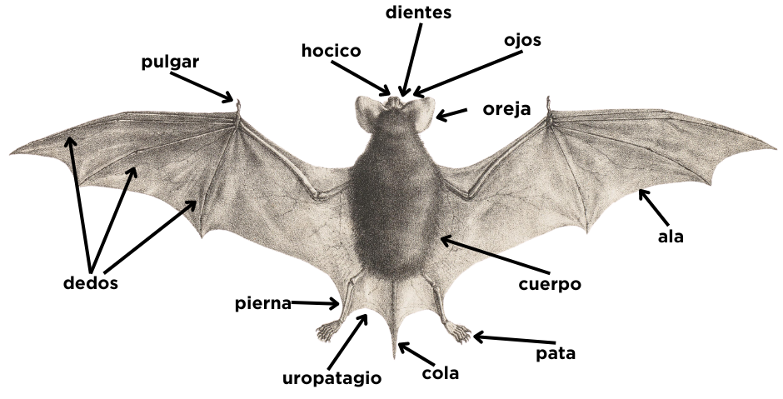
Murciélago mexicano de cola libre
también conocido como Murciélago brasileño de cola libre
Tadarida brasiliensis
Bat Image By Iconographia Zoologica, Public Domain, https://commons.wikimedia.org/w/index.php?curid=55099120, labels added by Deep in the Heart October 2023
Notes:
Bat Image By Iconographia Zoologica, Public Domain, https://commons.wikimedia.org/w/index.php?curid=55099120, labels added by Deep in the Heart October 2023

Slide 9
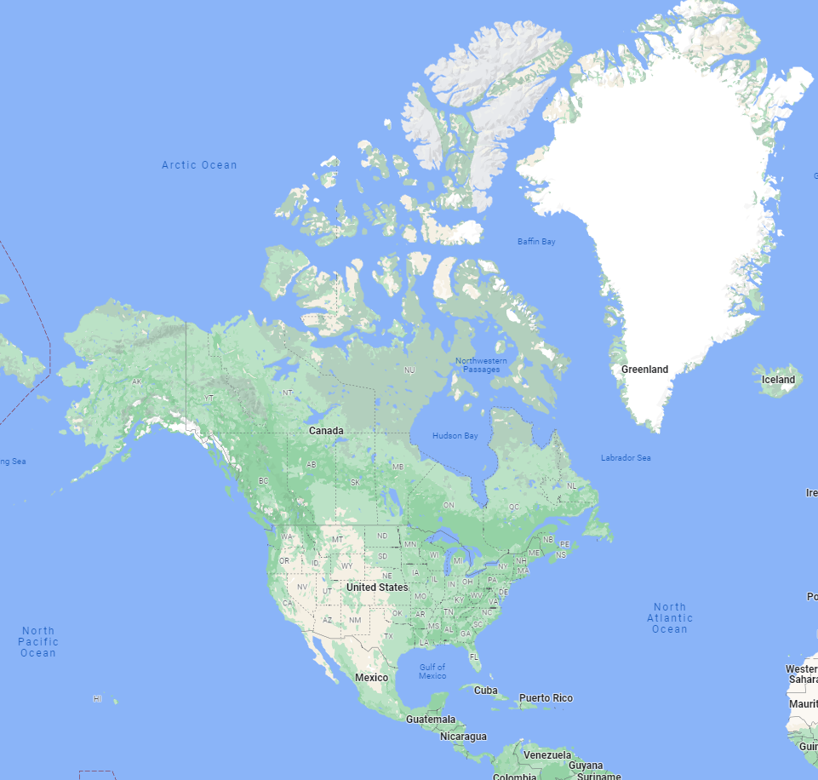

O
¿Dónde está Texas?
Google Maps
Notes:
Map from Google Maps
Compass Rose by imaginationlol on Flaticon https://www.flaticon.com/free-icon/wind-rose_4031900?term=compass+rose&page=1&position=2&origin=search&related_id=4031900
Modified for Spanish
Star Graphic from PowerPoint

Slide 10
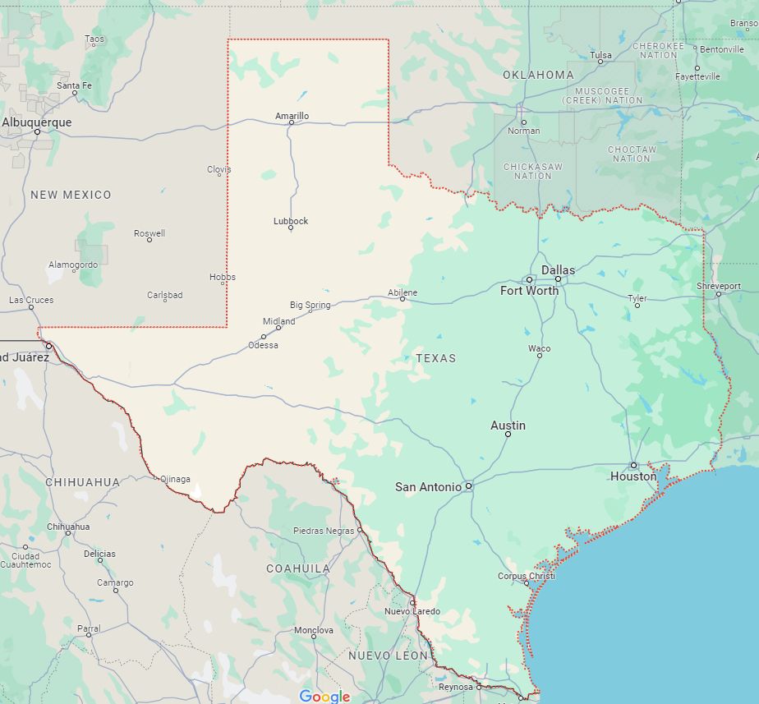
¿Dónde está la cueva Bracken?
O
Notes:
Discuss where students live in relation to Bracken Cave. Questions to guide the discussion may include:
Do you live north, east, south, or west of Bracken Cave?
Have you ever been to Bracken Cave? What was it like?
Have you ever been to any cave? What was it like?
Map from Google Maps
Compass Rose by imaginationlol on Flaticon https://www.flaticon.com/free-icon/wind-rose_4031900?term=compass+rose&page=1&position=2&origin=search&related_id=4031900
Modified for Spanish

Slide 11
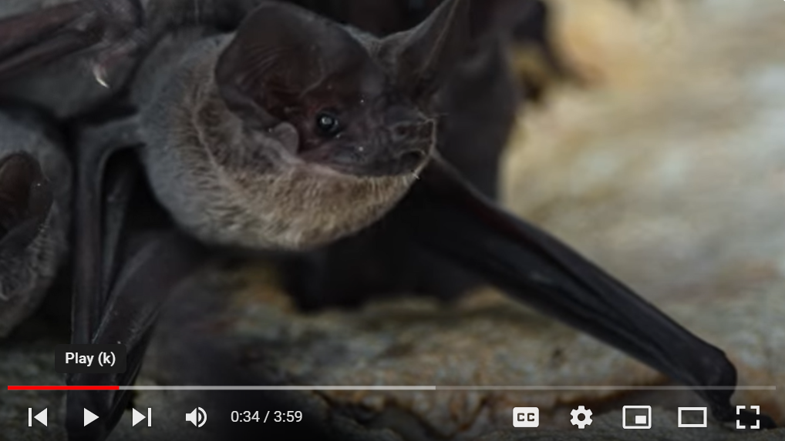
Notes:
Deep in the Heart Bats of Bracken Cave This video is also available on YouTube: https://youtu.be/H-q58Jd50Lk?si=1j1TePoUr2TrAiua The video is 4 minutes long.

Slide 12
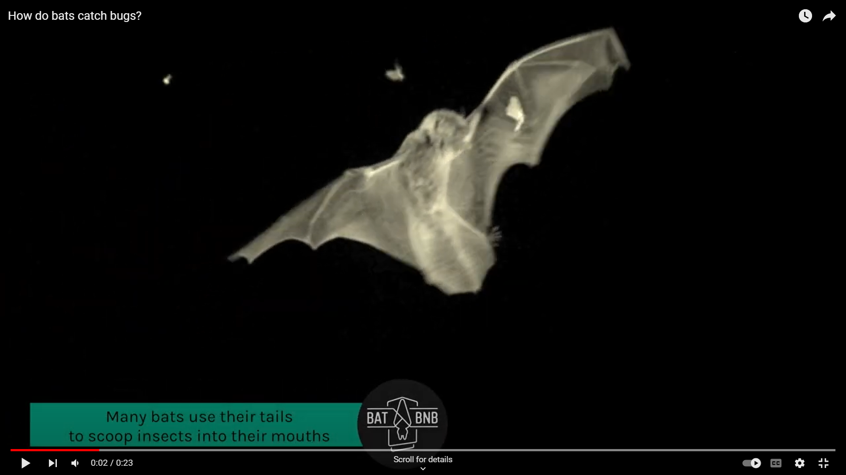
Notes:
How do bats catch bugs? by BatBnB. The clip is also available on YouTube: https://www.youtube.com/watch?v=zd-X3Pi8Oz0. This video is 23 seconds long.

Slide 13

¿Cómo se mueven
los murciélagos mexicanos de cola libre?
MURCIÉLAGOS MEXICANOS DE COLA LIBRE
Notes:
Note: Use the images on the next slide to guide a discussion that answers this question.

Slide 14
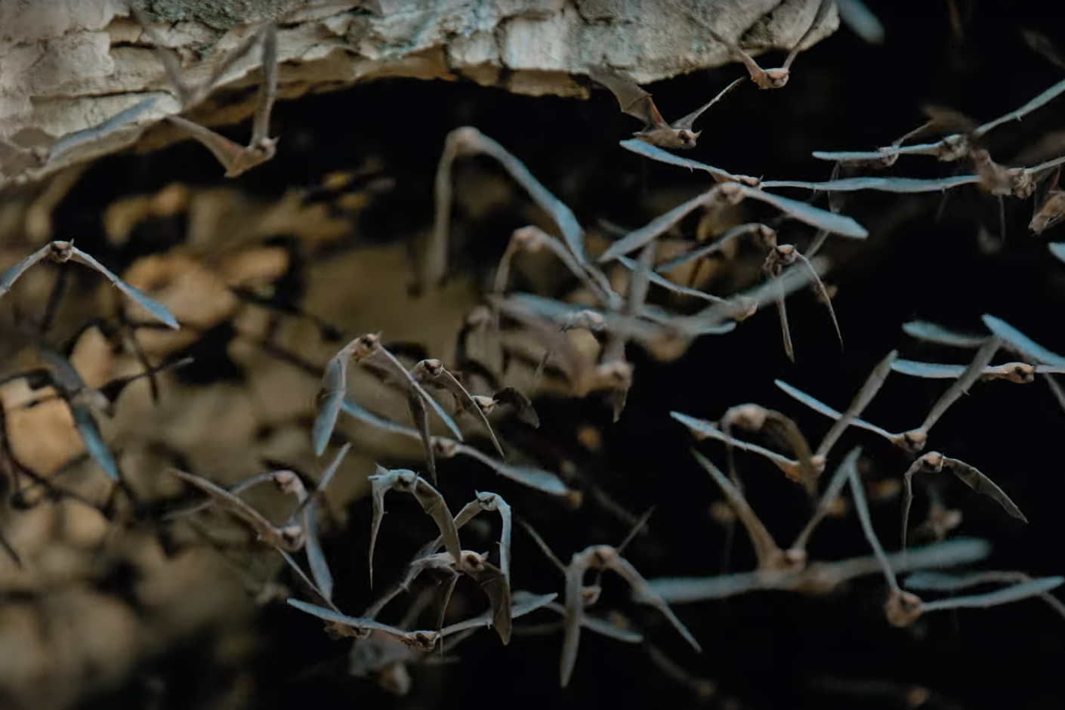
Image: Fin & Fur Films Productions
Image: Fin & Fur Films Productions
MURCIÉLAGOS MEXICANOS DE COLA LIBRE
Notes:
How do Mexican free-tailed bats move?
Discussion points:
i. Mexican free-tailed bats use their wings to fly.
ii. They use their wings, thumbs, legs, and feet to crawl on the ground and along the sides of caves and other structures.
Mexican free-tailed bat images: Fin & Fur Films Productions

Slide 15
¿Cómo los murciélagos mexicanos de cola libre se cuelgan boca abajo?
MURCIÉLAGOS MEXICANOS DE COLA LIBRE
Notes:
Note: Use the image on the next slide to guide a discussion that answers this question.

Slide 16
Image: Fin & Fur Films Productions
MURCIÉLAGOS MEXICANOS DE COLA LIBRE
Notes:
How do Mexican free-tailed bats hang upside down?
Discussion points:
i. Mexican free-tailed bats use the claws on their feet to hold on and hang upside down.
Mexican free-tailed bats image: Fin & Fur Films Productions

Slide 17
¿Cómo cazan insectos los murciélagos mexicanos de cola libre?
MURCIÉLAGOS MEXICANOS DE COLA LIBRE
Notes:
Note: Use the diagram on the next slide to guide a discussion that answers this question.

Slide 18
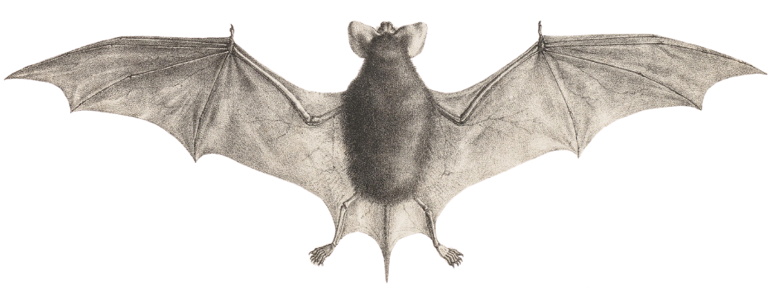
Bat Image by Iconographia Zoologica, Public Domain, https://commons.wikimedia.org/w/index.php?curid=55099120
MURCIÉLAGOS MEXICANOS DE COLA LIBRE
Notes:
How do Mexican free-tailed bats catch insects?
Discussion points:
Mexican free-tailed bats catch insects while flying.
A Mexican free-tailed bat uses its uropatagium, the skin membrane between its legs and tail, to scoop an insect into its mouth.
While Mexican free-tailed bats do rely on eyesight to some extent, they also use echolocation to determine the location of insects.
Bat image by Iconographia Zoologica, Public Domain, https://commons.wikimedia.org/w/index.php?curid=55099120

